Slide 1





Real-time intrusion detection for immediate threat response
Automated actions (e.g., activate lights, lock doors) to deter intruders
Seamless remote monitoring via web and mobile platforms
Designed for optimal protection, scalability, and user convenience
X
THIEF DETECTOR
The System is a smart home security solution that detects intrusions in real time. It uses a microservice-based IoT architecture with simulated sensors and automation, making it scalable and easy to test without physical hardware. Users can monitor activity and receive alerts via a web dashboard, Telegram bot, and ThingSpeak cloud, ensuring remote access and reliable protection.

Slide 2

Real-time intrusion detection for immediate threat response
Automated actions (e.g., activate lights ) to detect intruders
Seamless remote monitoring via web and mobile platforms
Designed for optimal protection, scalability, and user convenience
THIEF DETECTOR
IoT and Cloud for sustainable communities
Group 3:
Arash Omidi
Farinaz Goli
Ramin Rashidi
Elmira Abedpour
Atefeh Roshanaee
THIEF DETECTOR
The System is a smart home security solution that detects intrusions in real time. It uses a microservice-based IoT architecture with simulated sensors and automation, making it scalable and easy to test without physical hardware. Users can monitor activity and receive alerts via a web dashboard, Telegram bot, and ThingSpeak cloud, ensuring remote access and reliable protection.

Slide 3


Solution
Problem
X
Traditional home security systems are expensive and hardware-dependent
Many systems lack real-time intrusion detection
Limited automation and integration between devices
Lack of accuracy and non-optimal old systems
The System is a smart home security solution that detects intrusions in real time. It uses a microservice-based IoT architecture with simulated sensors and automation, making it scalable and easy to test without physical hardware. Users can monitor activity and receive alerts via a web dashboard, Telegram bot, and ThingSpeak cloud, ensuring remote access and reliable protection.
THIEF DETECTOR
Real-time intrusion detection for immediate threat response
Automated actions (e.g., activate lights ) to detect intruders
Seamless remote monitoring via web and mobile platforms
Designed for optimal protection, scalability, and user convenience
X
INTRODUCTION
Project goal
THIEF DETECTOR
IoT-based system for real-time data exchange
Microservice architecture for scalability & flexibility
Automation logic in the Control Unit to trigger actions instantly
User interfaces:
Web Dashboard
Telegram Bot
ThingSpeak Cloud Dashboard

Slide 4

Connectivity: Uses MQTT for real-time communication (e.g., between sensors and Telegram Bot) and Rest web service as consumer and provider system.
Sensors: BH1750 Light sensor and HC-SR501 PIR Motion Sensor.
docker
Everything runs as containers with Docker Compose
THIEF DETECTOR
IoT-based system for real-time data exchange
Microservice architecture for scalability & flexibility
Automation logic in the Control Unit to trigger actions instantly
User interfaces:
Web Dashboard
Telegram Bot
ThingSpeak Cloud Dashboard
Many systems lack real-time intrusion detection
Limited automation and integration between devices
Lack of accuracy and non-optimal old systems
X
Solution
Problem
Sensor Connector: plays the role of a Raspberry Pi reading light & motion sensors.
Actuator Connector: plays the role of an Arduino controlling lights
Actuators: 5V Relay Switch
INTRODUCTION
Project goal

Slide 5
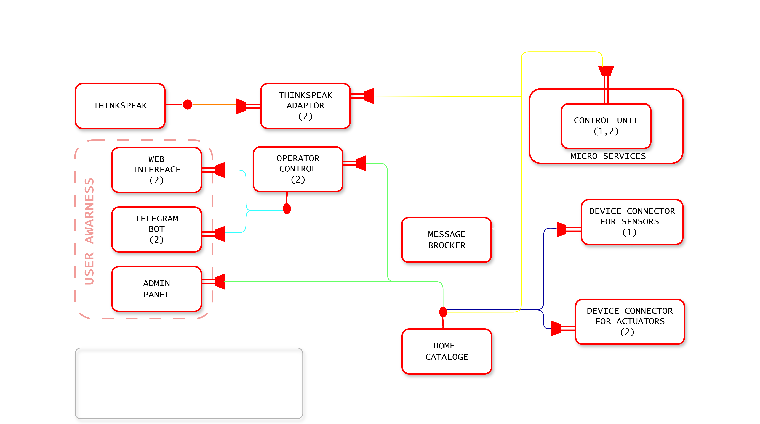
Components
Sensors: BH1750 Light sensor and HC-SR501 PIR Motion Sensor.
Connectivity: Uses MQTT for real-time communication (e.g., between sensors and Telegram Bot) and Rest web service as consumer and provider system.
X
Sensor Connector: plays the role of a Raspberry Pi reading light & motion sensors.
Actuator Connector: plays the role of an Arduino controlling lights
Actuators: 5V Relay Switch
INTRODUCTION
Project goal

Slide 6
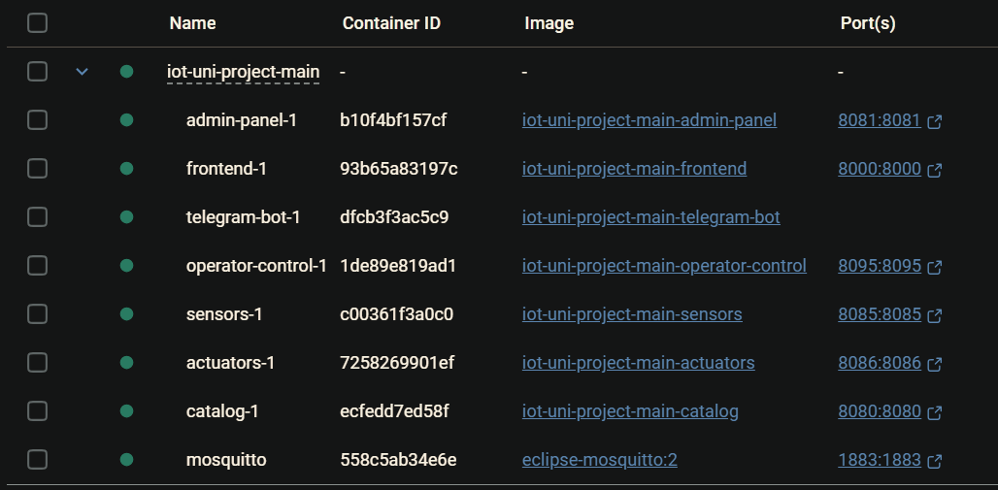

Connectivity: Uses MQTT for real-time communication (e.g., between sensors and Telegram Bot) and Rest web service for data transfer to Thingspeak.
Sensors: BH1750 Light sensor and HC-SR501 PIR Motion Sensor.
docker
Everything runs as containers with Docker Compose
Admin-panel • 8081 — System management
Frontend • 8000 — Web dashboard
Telegram-bot —Alerts & menu
Operator-control — REST API & control
Sensors —Publishes sensor events
Actuators —Executes device commands
Catalog • 8080 — Registry/config
Mosquitto — MQTT broker
Adaptor — Thingspeak adaptor
Raspberry Pi Role: Acts as the central controller, connecting all components and managing the system via GPIO pins.
Actuators: Raspberry Pi Camera Module, Piezo Buzzer/Speaker, and 5V Relay Module.

Slide 7
IoT-based system for real-time data exchange
Microservice architecture for scalability & flexibility
Simulated sensors and actuators for development without physical devices
Automation logic in the Control Unit to trigger actions instantly
User interfaces:
Web Dashboard
Telegram Bot
ThingSpeak Cloud Dashboard
X
docker
Everything runs as containers with Docker Compose
Admin-panel • 8081 — System management
Frontend • 8000 — Web dashboard
Telegram-bot —Alerts & menu
Operator-control — REST API & control
Sensors —Publishes sensor events
Actuators —Executes device commands
Catalog • 8080 — Registry/config
Mosquitto — MQTT broker
Adaptor — Thingspeak adaptor
Device layer
Traditional home security systems are expensive and hardware-dependent
Many systems lack real-time intrusion detection
Limited automation and integration between devices
Lack of accuracy and non-optimal old systems

Slide 8
Real-time intrusion detection for immediate threat response
Automated actions (e.g., activate lights, lock doors) to deter intruders
Seamless remote monitoring via web and mobile platforms
Designed for optimal protection, scalability, and user convenience
X
X
Acts as a bridge between sensors/actuators and the MQTT message broker.
Knows how each device should connect and forwards sensor data to the broker.
Uses a helper called Device Connector Instantiator:
• Instantiator creates objects for each device based on configuration.
• This allows one Device Connector to manage multiple sensors or actuators.
• Registers devices with the Catalog so the system can discover them.
Device layer
Device connector
The System is a smart home security solution that detects intrusions in real time. It uses a microservice-based IoT architecture with simulated sensors and automation, making it scalable and easy to test without physical hardware. Users can monitor activity and receive alerts via a web dashboard, Telegram bot, and ThingSpeak cloud, ensuring remote access and reliable protection.
Notes:
I want to explain about parts of the project called device connector, the sensors and the actuators. These 3 pieces are the foundation of how our iot project actually works.

Slide 9
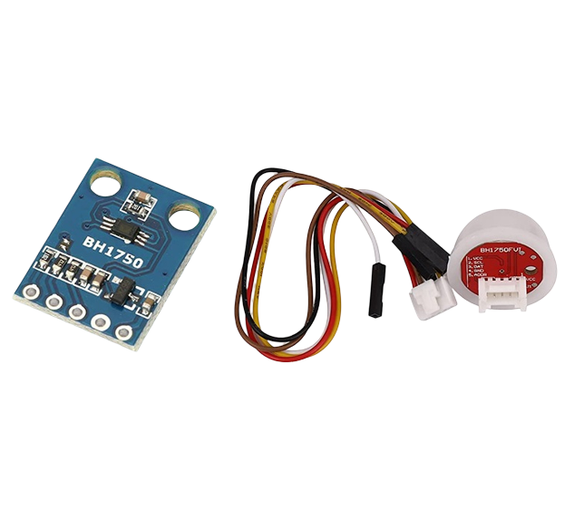
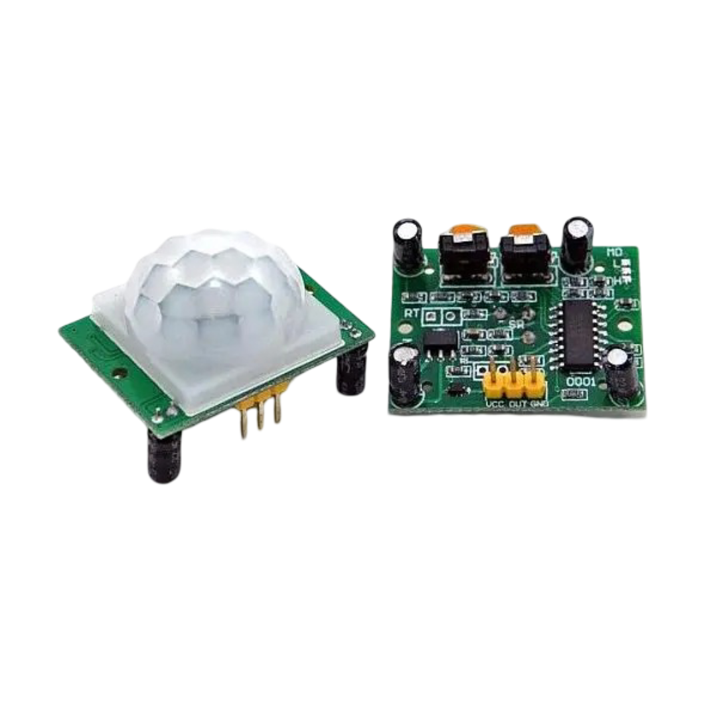
X
X
Acts as a bridge between sensors/actuators and the MQTT message broker.
Knows how each device should connect and forwards sensor data to the broker.
Uses a helper called Device Connector Instantiator:
• Instantiator creates objects for each device based on configuration.
• This allows one Device Connector to manage multiple sensors or actuators.
• Registers devices with the Catalog so the system can discover them.
Device connector
Sensors
X
X
light Sensors
motion Sensors
motion Sensors
Notes:
Let’s start with the Device Connector. You can think of it as a bridge between the physical devices, sensors and actuators and the MQTT message broker. Its main job is to understand how each sensor or actuator should connect, and forward sensor data or listen for commands. To manage this circulation in a flexible way, we use something called the Device Connector Instantiator. The instantiator creates objects for each device, which means one connector can handle multiple sensors or actuators at the same time. This object-oriented structure makes the system scalable.

Slide 10
import random
import time
class LightSensor():
def __init__(self, sensor_id, min_lux=0, max_lux=1000):
self.sensor_id = sensor_id
self.MIN_LIGHT = min_lux
self.MAX_LIGHT = max_lux
self.senKind = "Light"
self.unit = "lux“
def generate_data(self):
value = round(random.uniform(self.MIN_LIGHT, self.MAX_LIGHT), 2)
return value
def get_info(self):
return (self.sensor_id, self.senKind, self.unit)
class MotionSensor():
def __init__(self, sensor_id):
self.sensor_id = sensor_id
self.senKind = "Motion"
self.unit = "boolean"
def generate_data(self):
return random.choices([True, False], weights=[1, 15])[0]
def get_info(self):
return (self.sensor_id, self.senKind, self.unit)
X
X
X
X
Light sensor:
simulating a light sensor by generating random lux values within a range and providing sensor details (ID, type, unit)
Motion Sensor:
simulating a motion sensor with a small chance of detecting movement (True/False) and provides sensor details.
Simulating detection; out of 16 readings, 15 are “No Motion” and 1 is “Detected”.
• Both sensors produce data in SenML message format.
• Device Connector publishes these readings to the broker at fixed time intervals.
light Sensors
motion Sensors
Sensors
Device connector
Notes:
Next topic is the Sensors. We simulate two types of sensors. The Light Sensor produces random lux values, represent the light level. The Motion Sensor simulates movement detection and works randomly, most of the time out of sixteen motion, it just reports one. This behavior creates a realistic scenario because movement doesn't happen all the time. Both sensors wrap their data in a standard SenML message format, which includes the sensor name, unit, timestamp, and value. The Device Connector sends these sensor messages to the MQTT broker every few seconds, so the Control Unit and the dashboard can use the data.

Slide 11
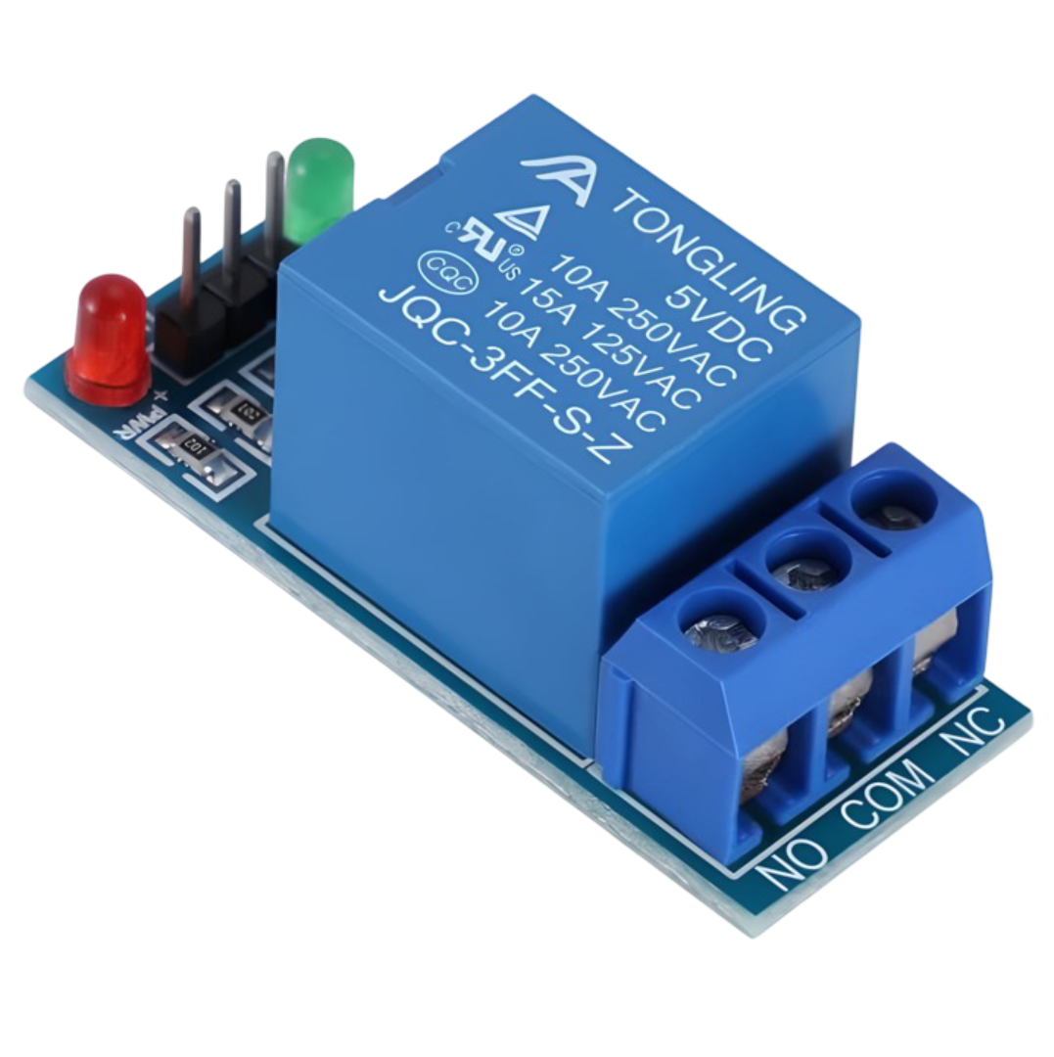
X
X
light Sensors
motion Sensors
The system also supports actuators, for example relay switches.
Actuator Device Connector:
• Manages the connection of actuators to the broker.
• Receives commands via MQTT instead of sending measurements.
Actuator Device Connector Instantiator:
• Creates one object per relay switch.
• Each object uses the same logic inside the Actuator Device Connector to process commands.
Photoresistor (BH1750)
The BH1750 is digital, connects directly to GPIO pins, and is more accurate for ambient light measurement.
It measures light levels and can trigger actions if it’s dark (turning on lights).
Available on Amazon or AliExpress as “BH1750 Light Sensor Module”.
HC-SR501 PIR Motion Sensor
It’s very common, affordable, and works directly with Raspberry Pi’s GPIO pins.
Detects human or object movement using infrared.
It sends a signal when motion is detected, which can trigger an alarm or photo.
Found in electronics markets or on eBay with a search for (HC-SR501 PIR Sensor).
X
Relay switch
Notes:
For our sensors we use photoresistor BH1750 which is digital and more accurate for ambient light measurement, and hc-sr501 as the motion sensor that works directly with the raspberry pi.

Slide 12
X
The system also supports actuators, for example relay switches.
Actuator Device Connector:
• Manages the connection of actuators to the broker.
• Receives commands via MQTT instead of sending measurements.
Actuator Device Connector Instantiator:
• Creates one object per relay switch.
• Each object uses the same logic inside the Actuator Device Connector to process commands.
Actuators
X
X
light Sensors
motion Sensors
X
Relay switch
Notes:
Finally, we have the Actuators, which in our project are represented by relay switches. The Actuator Device Connector is similar to the sensor connector, but instead of sending data, it subscribes to MQTT topics and listens for commands. For example, the system may send a command to turn on a light when motion is detected. The Actuator Instantiator creates an object for each relay, allowing us to control several relays independently. When a command arrives, the actuator updates its status, for instance, switching a lamp on or off.

Slide 13
class Device_connector_act():
exposed = True
def __init__(self, catalog_url, DCConfiguration, baseClientID, DCID):
self.catalog_url = catalog_url
self.DCConfiguration = DCConfiguration
self.clientID = f"{baseClientID}_{DCID}_DCA_{int(time.time())}"
self.devices = self.DCConfiguration.get("devicesList", [])
try:
self.houseID, self.floorID, self.unitID = DCID.split("-")
except ValueError:
print(f"Error parsing DCID '{DCID}'.")
return
try:
broker, port = self.get_broker()
self.client = MyMQTT(self.clientID, broker, port, self)
self.client.start()
print(f"[{self.clientID}] MQTT client started.")
topic = f"ThiefDetector/commands/{self.houseID}/{self.floorID}/{self.unitID}/#"
self.client.mySubscribe(topic)
print(f"[{self.clientID}] Subscribed to topic: {topic}")
except Exception as e:
print(f"[{self.clientID} ERROR] Failed to start MQTT client: {e}")
@cherrypy.tools.json_out()
def GET(self, *uri, **params):
if len(uri) > 0 and uri[0] == "devices":
return self.devices
return "Go to '/devices' to see the devices list."
def notify(self, topic, payload):
print(f"[{self.clientID} NOTIFY] Command received on topic: {topic}")
try:
event = payload.get("e", [{}])[0]
deviceStatusValue = event.get("v", "unknown")
deviceName = topic.split("/")[-1]
for device in self.devices:
if device["deviceName"].lower() == deviceName.lower():
print(f"[{self.clientID}] Updating '{deviceName}' status to '{deviceStatusValue}'")
device["deviceStatus"] = deviceStatusValue
device["lastUpdate"] = time.strftime("%Y-%m-%d %H:%M:%S")
except Exception as e:
print(f"[{self.clientID} ERROR] Unexpected error in notify: {e}")
def stop(self):
self.client.stop()
print(f"[{self.clientID}] MQTT client stopped.")
def get_broker(self):
req_b = requests.get(f"{self.catalog_url}/broker")
req_b.raise_for_status()
broker_json = req_b.json()
return broker_json["IP"], int(broker_json["port"])
X
X
Relay switch
Infrastructur layer
Relay switch: 5V Single Channel Relay Module.
Works with Raspberry Pi’s GPIO and can control electrical devices (like a lamp).
Simple and ideal for home projects.
It connects or cuts power to a device (a lamp) based on a signal from the Raspberry Pi.
Found in electronics markets or AliExpress with a search for (5V Relay Module).
X
X
light Sensors
motion Sensors
Notes:
At last, our relay switch is 5v single channel relay module which is suitable for raspberry pi and simple and ideal for home projects.

Slide 14
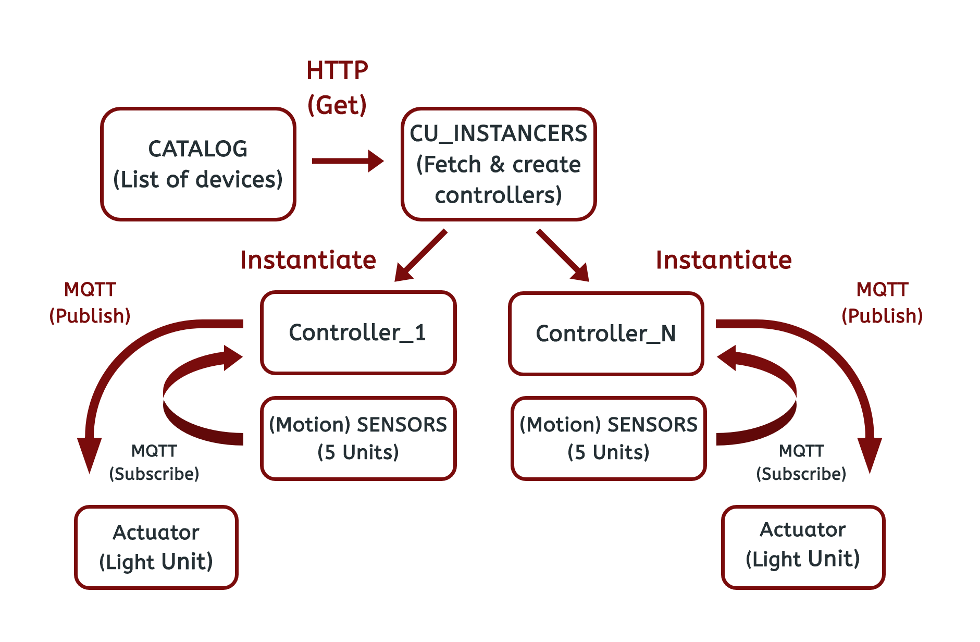
X
Infrastructur layer

Slide 15
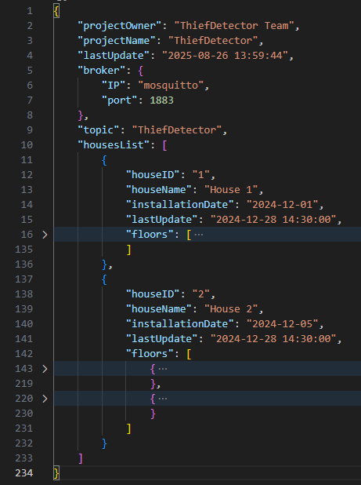
X
CATALOG.JSON
Control
unit
The Catalog.json contains:
Project information
Broker details
Topic name
Houses list
Cu-instancer
Catalog
catalog
registry
infrastructure
Notes:
The catalog is the digital registry of the whole IoT system. It contains the broker configuration, then the hierarchy of houses → floors → units. Each unit has URLs to contact its sensors and actuators, plus a list of devices with their location, services, and MQTT topics. This makes it easy for any new connector or service to discover what devices exist and how to communicate with them.

Slide 16
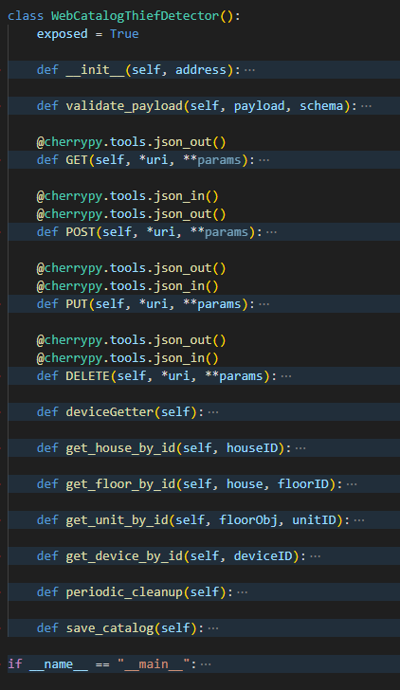
X
A RESTful web service that performs CRUD operations on the Catalog JSON, manages devices list, and handles periodic catalog clean-up.
Catalog
Cu-
instancer
catalog
registry
Control
unit
infrastructure
Catalog
POST/ PUT
HTTP
GET
Control-Unit
Notes:
Purpose
Central “phonebook” of the system: keeps track of houses, floors, units, and devices.
Provides access for other services (sensors, actuators, dashboards) through REST APIs.
Structure
Data stored in catalog.json.
Organized in hierarchy:
House → Floor → Unit → Devices.
Each device has:
ID, name, status, location (house/floor/unit), type, services, last update.

Slide 17
.
import cherrypy
import json
import datetime
import sched
import time
import os
DEVICE_SCHEMA = {
"deviceID": {"type": (int, str), "required": True},
"deviceName": {"type": str, "required": True},
"deviceStatus": {"type": str, "required": True},
"availableStatuses": {"type": list, "required": True},
"deviceLocation": {"type": dict, "required": True},
"measureType": {"type": list, "required": True},
"availableServices": {"type": list, "required": True},
"servicesDetails": {"type": list, "required": True},
}
HOUSE_SCHEMA = {
"houseID": {"type": str, "required": True},
"houseName": {"type": str, "required": True},
"floors": {"type": list, "required": True},
}
class WebCatalogThiefDetector():
exposed = True
def __init__(self, address):
with open(address, 'r') as fptr:
self.catalog = json.load(fptr)
self.mainTopic = self.catalog["projectName"]
self.broker = self.catalog["broker"]
self.housesList = self.catalog["housesList"]
self.deviceGetter()
self.scheduler = sched.scheduler(time.time, time.sleep)
self.scheduler.enter(0, 1, self.periodic_cleanup, ())
self.scheduler.run(blocking=False)
def validate_payload(self, payload, schema):
"""
Validates a payload against a given schema.
Returns a list of errors. If the list is empty, the payload is valid.
"""
errors = []
for field, rules in schema.items():
if rules.get("required") and field not in payload:
errors.append(f"Missing required field: '{field}'")
continue
if field in payload and not isinstance(payload[field], rules["type"]):
errors.append(f"Invalid type for field '{field}'. Expected {rules['type']}, got {type(payload[field])}")
return errors
@cherrypy.tools.json_out()
def GET(self, *uri, **params):
if len(uri) == 0:
return "No valid URL. Try /broker, /devices, /device/{id}, /houses, /house/{houseID}, /topic"
path = uri[0].lower()
if path == "broker":
return self.broker
elif path == "devices":
return self.devices
elif path == "device":
if len(uri) < 2:
return "No device ID provided. Try /device/{id}"
deviceID = uri[1]
theDevice = self.get_device_by_id(deviceID)
return theDevice if theDevice else f"No device found with ID {deviceID}"
elif path == "houses":
return self.housesList
elif path == "house":
if len(uri) < 2:
return "No house ID provided. Try /house/{houseID}"
houseID = uri[1]
theHouse = self.get_house_by_id(houseID)
return theHouse if theHouse else f"No house found with ID {houseID}"
elif path == "topic":
return self.mainTopic
elif path == "houseshow":
house = self.catalog["housesList"][0]
return house
else:
return "Invalid URL. Try /broker, /devices, /device/{id}, /houses, /house/{houseID}, /topic"
@cherrypy.tools.json_in()
@cherrypy.tools.json_out()
def POST(self, *uri, **params):
if len(uri) == 0:
return "Use /houses or /devices to add new items."
path = uri[0].lower()
if path == "houses":
newHouse = cherrypy.request.json
errors = self.validate_payload(newHouse, HOUSE_SCHEMA)
if errors:
return {"errors": errors}
newHouse["lastUpdate"] = datetime.datetime.now().strftime("%Y-%m-%d %H:%M:%S")
self.housesList.append(newHouse)
self.catalog["lastUpdate"] = newHouse["lastUpdate"]
self.save_catalog()
self.deviceGetter()
return "House added successfully", 201
elif path == "devices":
newDevice = cherrypy.request.json
errors = self.validate_payload(newDevice, DEVICE_SCHEMA)
if errors:
return {"errors": errors}
theTime = datetime.datetime.now().strftime("%Y-%m-%d %H:%M:%S")
newDevice["lastUpdate"] = theTime
try:
houseID = str(newDevice["deviceLocation"]["houseID"])
floorID = str(newDevice["deviceLocation"]["floorID"])
unitID = str(newDevice["deviceLocation"]["unitID"])
except KeyError:
return "deviceLocation must contain houseID, floorID, unitID"
house = self.get_house_by_id(houseID)
if not house:
return f"No house found with ID {houseID}"
floorObj = self.get_floor_by_id(house, floorID)
if not floorObj:
return f"No floor {floorID} found in house {houseID}"
unitObj = self.get_unit_by_id(floorObj, unitID)
if not unitObj:
return f"No unit {unitID} found on floor {floorID} of house {houseID}"
existing_index = None
for i, dev in enumerate(unitObj["devicesList"]):
if str(dev.get("deviceID")) == str(newDevice.get("deviceID")):
existing_index = i
break
if existing_index is not None:
unitObj["devicesList"][existing_index] = newDevice
else:
unitObj["devicesList"].append(newDevice)
self.catalog["lastUpdate"] = theTime
self.save_catalog()
self.deviceGetter()
return "Device added successfully", 201
else:
return "Invalid path. Use /houses or /devices to add new items."
@cherrypy.tools.json_out()
@cherrypy.tools.json_in()
def PUT(self, *uri, **params):
if len(uri) == 0:
return "Use /houses or /devices to update existing items."
path = uri[0].lower()
if path == "houses":
body = cherrypy.request.json
errors = self.validate_payload(body, HOUSE_SCHEMA)
if errors:
return {"errors": errors}
houseID = str(body.get("houseID") or params.get("houseID"))
if not houseID:
return "No houseID specified to update."
house = self.get_house_by_id(houseID)
if not house:
return f"No house found with ID {houseID}", 404
for k, v in body.items():
house[k] = v
house["lastUpdate"] = datetime.datetime.now().strftime("%Y-%m-%d %H:%M:%S")
self.catalog["lastUpdate"] = house["lastUpdate"]
print(f"Updated house {houseID} with data: {body}")
self.save_catalog()
self.deviceGetter()
return "House updated successfully", 200
elif path == "devices":
updatedDevice = cherrypy.request.json
errors = self.validate_payload(updatedDevice, DEVICE_SCHEMA)
if errors:
return {"errors": errors}
theTime = datetime.datetime.now().strftime("%Y-%m-%d %H:%M:%S")
updatedDevice["lastUpdate"] = theTime
try:
houseID = str(updatedDevice["deviceLocation"]["houseID"])
floorID = str(updatedDevice["deviceLocation"]["floorID"])
unitID = str(updatedDevice["deviceLocation"]["unitID"])
except KeyError:
return "deviceLocation must contain houseID, floorID, unitID"
house = self.get_house_by_id(houseID)
if not house:
return f"No house found with ID {houseID}", 404
floorObj = self.get_floor_by_id(house, floorID)
if not floorObj:
return f"No floor {floorID} found in house {houseID}", 404
unitObj = self.get_unit_by_id(floorObj, unitID)
if not unitObj:
return f"No unit {unitID} found on floor {floorID} of house {houseID}", 404
existing_index = None
for i, dev in enumerate(unitObj["devicesList"]):
if str(dev["deviceID"]) == str(updatedDevice["deviceID"]):
existing_index = i
break
if existing_index is not None:
unitObj["devicesList"][existing_index] = updatedDevice
else:
unitObj["devicesList"].append(updatedDevice)
self.catalog["lastUpdate"] = theTime
self.save_catalog()
self.deviceGetter()
return "Device updated successfully", 200
else:
return "Invalid path. Use /houses or /devices to update items."
@cherrypy.tools.json_out()
@cherrypy.tools.json_in()
def DELETE(self, *uri, **params):
if len(uri) == 0:
return "To delete: /houses?houseID=... or /devices?deviceID=..."
path = uri[0].lower()
if path == "devices":
deviceID = params.get("deviceID")
if not deviceID:
return "Missing deviceID parameter."
removed = False
for house in self.housesList:
for floor in house.get("floors", []):
for unit in floor.get("units", []):
original = len(unit["devicesList"])
unit["devicesList"] = [
d for d in unit["devicesList"]
if str(d["deviceID"]) != str(deviceID)
]
if len(unit["devicesList"]) < original:
removed = True
if removed:
self.catalog["lastUpdate"] = datetime.datetime.now().strftime("%Y-%m-%d %H:%M:%S")
self.save_catalog()
self.deviceGetter()
return f"Device {deviceID} removed successfully.", 200
else:
return f"Device {deviceID} not found.", 404
def deviceGetter(self):
self.devices = []
for house in self.housesList:
for floorObj in house.get("floors", []):
for unitObj in floorObj.get("units", []):
for device in unitObj["devicesList"]:
self.devices.append(device)
def get_house_by_id(self, houseID):
return next((h for h in self.housesList if str(h["houseID"]) == str(houseID)), None)
def get_floor_by_id(self, house, floorID):
for f in house.get("floors", []):
if str(f["floorID"]) == str(floorID):
return f
return None
def get_unit_by_id(self, floorObj, unitID):
for u in floorObj.get("units", []):
if str(u["unitID"]) == str(unitID):
return u
return None
def get_device_by_id(self, deviceID):
for d in self.devices:
if str(d["deviceID"]) == str(deviceID):
return d
return None
def periodic_cleanup(self):
THRESHOLD = 1
now = datetime.datetime.now()
cutoff = now - datetime.timedelta(hours=THRESHOLD)
for house in self.housesList:
for floorObj in house.get("floors", []):
for unitObj in floorObj.get("units", []):
unitObj["devicesList"] = [
dev for dev in unitObj["devicesList"]
if datetime.datetime.strptime(
dev.get('lastUpdate', '1970-01-01 00:00:00'),
"%Y-%m-%d %H:%M:%S"
) >= cutoff
]
self.catalog["lastUpdate"] = now.strftime("%Y-%m-%d %H:%M:%S")
self.save_catalog()
self.deviceGetter()
self.scheduler.enter(600, 1, self.periodic_cleanup, ())
def save_catalog(self):
try:
script_dir = os.path.dirname(__file__)
catalog_file_path = os.path.join(script_dir, 'catalog.json')
with open(catalog_file_path, 'w') as fptr:
print(f"Saving catalog to {catalog_file_path}")
json.dump(self.catalog, fptr, indent=4)
except Exception as e:
print(f"Error saving catalog: {e}")
if __name__ == "__main__":
conf = {
"/": {
'request.dispatch': cherrypy.dispatch.MethodDispatcher(),
'tools.sessions.on': True
}
}
cherrypy.config.update({'server.socket_host': '0.0.0.0'})
webService = WebCatalogThiefDetector('catalog.json')
cherrypy.tree.mount(webService, '/', conf)
cherrypy.engine.start()
try:
cherrypy.engine.block()
except KeyboardInterrupt:
print("Shutting down...")
cherrypy.engine.stop()
finally:
cherrypy.engine.block()
X
The GET method returns details about:
Broker
Devices
Houses
Catalog
Cu-
instancer
catalog
registry
Control
unit
infrastructure
Catalog
POST/ PUT
HTTP
GET
Control-Unit
Notes:
GET:
/broker → returns MQTT broker info.
/devices → all devices (flat list).
/device/{id} → details of one device.
/houses → all houses with full structure.
/house/{id} → details of one house.
/topic → project topic name.

Slide 18
.
import cherrypy
import json
import datetime
import sched
import time
import os
DEVICE_SCHEMA = {
"deviceID": {"type": (int, str), "required": True},
"deviceName": {"type": str, "required": True},
"deviceStatus": {"type": str, "required": True},
"availableStatuses": {"type": list, "required": True},
"deviceLocation": {"type": dict, "required": True},
"measureType": {"type": list, "required": True},
"availableServices": {"type": list, "required": True},
"servicesDetails": {"type": list, "required": True},
}
HOUSE_SCHEMA = {
"houseID": {"type": str, "required": True},
"houseName": {"type": str, "required": True},
"floors": {"type": list, "required": True},
}
class WebCatalogThiefDetector():
exposed = True
def __init__(self, address):
with open(address, 'r') as fptr:
self.catalog = json.load(fptr)
self.mainTopic = self.catalog["projectName"]
self.broker = self.catalog["broker"]
self.housesList = self.catalog["housesList"]
self.deviceGetter()
self.scheduler = sched.scheduler(time.time, time.sleep)
self.scheduler.enter(0, 1, self.periodic_cleanup, ())
self.scheduler.run(blocking=False)
def validate_payload(self, payload, schema):
"""
Validates a payload against a given schema.
Returns a list of errors. If the list is empty, the payload is valid.
"""
errors = []
for field, rules in schema.items():
if rules.get("required") and field not in payload:
errors.append(f"Missing required field: '{field}'")
continue
if field in payload and not isinstance(payload[field], rules["type"]):
errors.append(f"Invalid type for field '{field}'. Expected {rules['type']}, got {type(payload[field])}")
return errors
@cherrypy.tools.json_out()
def GET(self, *uri, **params):
if len(uri) == 0:
return "No valid URL. Try /broker, /devices, /device/{id}, /houses, /house/{houseID}, /topic"
path = uri[0].lower()
if path == "broker":
return self.broker
elif path == "devices":
return self.devices
elif path == "device":
if len(uri) < 2:
return "No device ID provided. Try /device/{id}"
deviceID = uri[1]
theDevice = self.get_device_by_id(deviceID)
return theDevice if theDevice else f"No device found with ID {deviceID}"
elif path == "houses":
return self.housesList
elif path == "house":
if len(uri) < 2:
return "No house ID provided. Try /house/{houseID}"
houseID = uri[1]
theHouse = self.get_house_by_id(houseID)
return theHouse if theHouse else f"No house found with ID {houseID}"
elif path == "topic":
return self.mainTopic
elif path == "houseshow":
house = self.catalog["housesList"][0]
return house
else:
return "Invalid URL. Try /broker, /devices, /device/{id}, /houses, /house/{houseID}, /topic"
@cherrypy.tools.json_in()
@cherrypy.tools.json_out()
def POST(self, *uri, **params):
if len(uri) == 0:
return "Use /houses or /devices to add new items."
path = uri[0].lower()
if path == "houses":
newHouse = cherrypy.request.json
errors = self.validate_payload(newHouse, HOUSE_SCHEMA)
if errors:
return {"errors": errors}
newHouse["lastUpdate"] = datetime.datetime.now().strftime("%Y-%m-%d %H:%M:%S")
self.housesList.append(newHouse)
self.catalog["lastUpdate"] = newHouse["lastUpdate"]
self.save_catalog()
self.deviceGetter()
return "House added successfully", 201
elif path == "devices":
newDevice = cherrypy.request.json
errors = self.validate_payload(newDevice, DEVICE_SCHEMA)
if errors:
return {"errors": errors}
theTime = datetime.datetime.now().strftime("%Y-%m-%d %H:%M:%S")
newDevice["lastUpdate"] = theTime
try:
houseID = str(newDevice["deviceLocation"]["houseID"])
floorID = str(newDevice["deviceLocation"]["floorID"])
unitID = str(newDevice["deviceLocation"]["unitID"])
except KeyError:
return "deviceLocation must contain houseID, floorID, unitID"
house = self.get_house_by_id(houseID)
if not house:
return f"No house found with ID {houseID}"
floorObj = self.get_floor_by_id(house, floorID)
if not floorObj:
return f"No floor {floorID} found in house {houseID}"
unitObj = self.get_unit_by_id(floorObj, unitID)
if not unitObj:
return f"No unit {unitID} found on floor {floorID} of house {houseID}"
existing_index = None
for i, dev in enumerate(unitObj["devicesList"]):
if str(dev.get("deviceID")) == str(newDevice.get("deviceID")):
existing_index = i
break
if existing_index is not None:
unitObj["devicesList"][existing_index] = newDevice
else:
unitObj["devicesList"].append(newDevice)
self.catalog["lastUpdate"] = theTime
self.save_catalog()
self.deviceGetter()
return "Device added successfully", 201
else:
return "Invalid path. Use /houses or /devices to add new items."
@cherrypy.tools.json_out()
@cherrypy.tools.json_in()
def PUT(self, *uri, **params):
if len(uri) == 0:
return "Use /houses or /devices to update existing items."
path = uri[0].lower()
if path == "houses":
body = cherrypy.request.json
errors = self.validate_payload(body, HOUSE_SCHEMA)
if errors:
return {"errors": errors}
houseID = str(body.get("houseID") or params.get("houseID"))
if not houseID:
return "No houseID specified to update."
house = self.get_house_by_id(houseID)
if not house:
return f"No house found with ID {houseID}", 404
for k, v in body.items():
house[k] = v
house["lastUpdate"] = datetime.datetime.now().strftime("%Y-%m-%d %H:%M:%S")
self.catalog["lastUpdate"] = house["lastUpdate"]
print(f"Updated house {houseID} with data: {body}")
self.save_catalog()
self.deviceGetter()
return "House updated successfully", 200
elif path == "devices":
updatedDevice = cherrypy.request.json
errors = self.validate_payload(updatedDevice, DEVICE_SCHEMA)
if errors:
return {"errors": errors}
theTime = datetime.datetime.now().strftime("%Y-%m-%d %H:%M:%S")
updatedDevice["lastUpdate"] = theTime
try:
houseID = str(updatedDevice["deviceLocation"]["houseID"])
floorID = str(updatedDevice["deviceLocation"]["floorID"])
unitID = str(updatedDevice["deviceLocation"]["unitID"])
except KeyError:
return "deviceLocation must contain houseID, floorID, unitID"
house = self.get_house_by_id(houseID)
if not house:
return f"No house found with ID {houseID}", 404
floorObj = self.get_floor_by_id(house, floorID)
if not floorObj:
return f"No floor {floorID} found in house {houseID}", 404
unitObj = self.get_unit_by_id(floorObj, unitID)
if not unitObj:
return f"No unit {unitID} found on floor {floorID} of house {houseID}", 404
existing_index = None
for i, dev in enumerate(unitObj["devicesList"]):
if str(dev["deviceID"]) == str(updatedDevice["deviceID"]):
existing_index = i
break
if existing_index is not None:
unitObj["devicesList"][existing_index] = updatedDevice
else:
unitObj["devicesList"].append(updatedDevice)
self.catalog["lastUpdate"] = theTime
self.save_catalog()
self.deviceGetter()
return "Device updated successfully", 200
else:
return "Invalid path. Use /houses or /devices to update items."
@cherrypy.tools.json_out()
@cherrypy.tools.json_in()
def DELETE(self, *uri, **params):
if len(uri) == 0:
return "To delete: /houses?houseID=... or /devices?deviceID=..."
path = uri[0].lower()
if path == "devices":
deviceID = params.get("deviceID")
if not deviceID:
return "Missing deviceID parameter."
removed = False
for house in self.housesList:
for floor in house.get("floors", []):
for unit in floor.get("units", []):
original = len(unit["devicesList"])
unit["devicesList"] = [
d for d in unit["devicesList"]
if str(d["deviceID"]) != str(deviceID)
]
if len(unit["devicesList"]) < original:
removed = True
if removed:
self.catalog["lastUpdate"] = datetime.datetime.now().strftime("%Y-%m-%d %H:%M:%S")
self.save_catalog()
self.deviceGetter()
return f"Device {deviceID} removed successfully.", 200
else:
return f"Device {deviceID} not found.", 404
def deviceGetter(self):
self.devices = []
for house in self.housesList:
for floorObj in house.get("floors", []):
for unitObj in floorObj.get("units", []):
for device in unitObj["devicesList"]:
self.devices.append(device)
def get_house_by_id(self, houseID):
return next((h for h in self.housesList if str(h["houseID"]) == str(houseID)), None)
def get_floor_by_id(self, house, floorID):
for f in house.get("floors", []):
if str(f["floorID"]) == str(floorID):
return f
return None
def get_unit_by_id(self, floorObj, unitID):
for u in floorObj.get("units", []):
if str(u["unitID"]) == str(unitID):
return u
return None
def get_device_by_id(self, deviceID):
for d in self.devices:
if str(d["deviceID"]) == str(deviceID):
return d
return None
def periodic_cleanup(self):
THRESHOLD = 1
now = datetime.datetime.now()
cutoff = now - datetime.timedelta(hours=THRESHOLD)
for house in self.housesList:
for floorObj in house.get("floors", []):
for unitObj in floorObj.get("units", []):
unitObj["devicesList"] = [
dev for dev in unitObj["devicesList"]
if datetime.datetime.strptime(
dev.get('lastUpdate', '1970-01-01 00:00:00'),
"%Y-%m-%d %H:%M:%S"
) >= cutoff
]
self.catalog["lastUpdate"] = now.strftime("%Y-%m-%d %H:%M:%S")
self.save_catalog()
self.deviceGetter()
self.scheduler.enter(600, 1, self.periodic_cleanup, ())
def save_catalog(self):
try:
script_dir = os.path.dirname(__file__)
catalog_file_path = os.path.join(script_dir, 'catalog.json')
with open(catalog_file_path, 'w') as fptr:
print(f"Saving catalog to {catalog_file_path}")
json.dump(self.catalog, fptr, indent=4)
except Exception as e:
print(f"Error saving catalog: {e}")
if __name__ == "__main__":
conf = {
"/": {
'request.dispatch': cherrypy.dispatch.MethodDispatcher(),
'tools.sessions.on': True
}
}
cherrypy.config.update({'server.socket_host': '0.0.0.0'})
webService = WebCatalogThiefDetector('catalog.json')
cherrypy.tree.mount(webService, '/', conf)
cherrypy.engine.start()
try:
cherrypy.engine.block()
except KeyboardInterrupt:
print("Shutting down...")
cherrypy.engine.stop()
finally:
cherrypy.engine.block()
X
Catalog
Cu-
instancer
catalog
registry
Control
unit
POST method:
Takes a JSON body as input
House details (to register a new house)•
Device details + location (to register/update a device)
Updates the Catalog by:
Adding new Houses•
Adding or updating Devices•
Refreshing lastUpdate automatically.
infrastructure
Catalog
POST/ PUT
HTTP
GET
Control-Unit

Slide 19
.
import cherrypy
import json
import datetime
import sched
import time
import os
DEVICE_SCHEMA = {
"deviceID": {"type": (int, str), "required": True},
"deviceName": {"type": str, "required": True},
"deviceStatus": {"type": str, "required": True},
"availableStatuses": {"type": list, "required": True},
"deviceLocation": {"type": dict, "required": True},
"measureType": {"type": list, "required": True},
"availableServices": {"type": list, "required": True},
"servicesDetails": {"type": list, "required": True},
}
HOUSE_SCHEMA = {
"houseID": {"type": str, "required": True},
"houseName": {"type": str, "required": True},
"floors": {"type": list, "required": True},
}
class WebCatalogThiefDetector():
exposed = True
def __init__(self, address):
with open(address, 'r') as fptr:
self.catalog = json.load(fptr)
self.mainTopic = self.catalog["projectName"]
self.broker = self.catalog["broker"]
self.housesList = self.catalog["housesList"]
self.deviceGetter()
self.scheduler = sched.scheduler(time.time, time.sleep)
self.scheduler.enter(0, 1, self.periodic_cleanup, ())
self.scheduler.run(blocking=False)
def validate_payload(self, payload, schema):
"""
Validates a payload against a given schema.
Returns a list of errors. If the list is empty, the payload is valid.
"""
errors = []
for field, rules in schema.items():
if rules.get("required") and field not in payload:
errors.append(f"Missing required field: '{field}'")
continue
if field in payload and not isinstance(payload[field], rules["type"]):
errors.append(f"Invalid type for field '{field}'. Expected {rules['type']}, got {type(payload[field])}")
return errors
@cherrypy.tools.json_out()
def GET(self, *uri, **params):
if len(uri) == 0:
return "No valid URL. Try /broker, /devices, /device/{id}, /houses, /house/{houseID}, /topic"
path = uri[0].lower()
if path == "broker":
return self.broker
elif path == "devices":
return self.devices
elif path == "device":
if len(uri) < 2:
return "No device ID provided. Try /device/{id}"
deviceID = uri[1]
theDevice = self.get_device_by_id(deviceID)
return theDevice if theDevice else f"No device found with ID {deviceID}"
elif path == "houses":
return self.housesList
elif path == "house":
if len(uri) < 2:
return "No house ID provided. Try /house/{houseID}"
houseID = uri[1]
theHouse = self.get_house_by_id(houseID)
return theHouse if theHouse else f"No house found with ID {houseID}"
elif path == "topic":
return self.mainTopic
elif path == "houseshow":
house = self.catalog["housesList"][0]
return house
else:
return "Invalid URL. Try /broker, /devices, /device/{id}, /houses, /house/{houseID}, /topic"
@cherrypy.tools.json_in()
@cherrypy.tools.json_out()
def POST(self, *uri, **params):
if len(uri) == 0:
return "Use /houses or /devices to add new items."
path = uri[0].lower()
if path == "houses":
newHouse = cherrypy.request.json
errors = self.validate_payload(newHouse, HOUSE_SCHEMA)
if errors:
return {"errors": errors}
newHouse["lastUpdate"] = datetime.datetime.now().strftime("%Y-%m-%d %H:%M:%S")
self.housesList.append(newHouse)
self.catalog["lastUpdate"] = newHouse["lastUpdate"]
self.save_catalog()
self.deviceGetter()
return "House added successfully", 201
elif path == "devices":
newDevice = cherrypy.request.json
errors = self.validate_payload(newDevice, DEVICE_SCHEMA)
if errors:
return {"errors": errors}
theTime = datetime.datetime.now().strftime("%Y-%m-%d %H:%M:%S")
newDevice["lastUpdate"] = theTime
try:
houseID = str(newDevice["deviceLocation"]["houseID"])
floorID = str(newDevice["deviceLocation"]["floorID"])
unitID = str(newDevice["deviceLocation"]["unitID"])
except KeyError:
return "deviceLocation must contain houseID, floorID, unitID"
house = self.get_house_by_id(houseID)
if not house:
return f"No house found with ID {houseID}"
floorObj = self.get_floor_by_id(house, floorID)
if not floorObj:
return f"No floor {floorID} found in house {houseID}"
unitObj = self.get_unit_by_id(floorObj, unitID)
if not unitObj:
return f"No unit {unitID} found on floor {floorID} of house {houseID}"
existing_index = None
for i, dev in enumerate(unitObj["devicesList"]):
if str(dev.get("deviceID")) == str(newDevice.get("deviceID")):
existing_index = i
break
if existing_index is not None:
unitObj["devicesList"][existing_index] = newDevice
else:
unitObj["devicesList"].append(newDevice)
self.catalog["lastUpdate"] = theTime
self.save_catalog()
self.deviceGetter()
return "Device added successfully", 201
else:
return "Invalid path. Use /houses or /devices to add new items."
@cherrypy.tools.json_out()
@cherrypy.tools.json_in()
def PUT(self, *uri, **params):
if len(uri) == 0:
return "Use /houses or /devices to update existing items."
path = uri[0].lower()
if path == "houses":
body = cherrypy.request.json
errors = self.validate_payload(body, HOUSE_SCHEMA)
if errors:
return {"errors": errors}
houseID = str(body.get("houseID") or params.get("houseID"))
if not houseID:
return "No houseID specified to update."
house = self.get_house_by_id(houseID)
if not house:
return f"No house found with ID {houseID}", 404
for k, v in body.items():
house[k] = v
house["lastUpdate"] = datetime.datetime.now().strftime("%Y-%m-%d %H:%M:%S")
self.catalog["lastUpdate"] = house["lastUpdate"]
print(f"Updated house {houseID} with data: {body}")
self.save_catalog()
self.deviceGetter()
return "House updated successfully", 200
elif path == "devices":
updatedDevice = cherrypy.request.json
errors = self.validate_payload(updatedDevice, DEVICE_SCHEMA)
if errors:
return {"errors": errors}
theTime = datetime.datetime.now().strftime("%Y-%m-%d %H:%M:%S")
updatedDevice["lastUpdate"] = theTime
try:
houseID = str(updatedDevice["deviceLocation"]["houseID"])
floorID = str(updatedDevice["deviceLocation"]["floorID"])
unitID = str(updatedDevice["deviceLocation"]["unitID"])
except KeyError:
return "deviceLocation must contain houseID, floorID, unitID"
house = self.get_house_by_id(houseID)
if not house:
return f"No house found with ID {houseID}", 404
floorObj = self.get_floor_by_id(house, floorID)
if not floorObj:
return f"No floor {floorID} found in house {houseID}", 404
unitObj = self.get_unit_by_id(floorObj, unitID)
if not unitObj:
return f"No unit {unitID} found on floor {floorID} of house {houseID}", 404
existing_index = None
for i, dev in enumerate(unitObj["devicesList"]):
if str(dev["deviceID"]) == str(updatedDevice["deviceID"]):
existing_index = i
break
if existing_index is not None:
unitObj["devicesList"][existing_index] = updatedDevice
else:
unitObj["devicesList"].append(updatedDevice)
self.catalog["lastUpdate"] = theTime
self.save_catalog()
self.deviceGetter()
return "Device updated successfully", 200
else:
return "Invalid path. Use /houses or /devices to update items."
@cherrypy.tools.json_out()
@cherrypy.tools.json_in()
def DELETE(self, *uri, **params):
if len(uri) == 0:
return "To delete: /houses?houseID=... or /devices?deviceID=..."
path = uri[0].lower()
if path == "devices":
deviceID = params.get("deviceID")
if not deviceID:
return "Missing deviceID parameter."
removed = False
for house in self.housesList:
for floor in house.get("floors", []):
for unit in floor.get("units", []):
original = len(unit["devicesList"])
unit["devicesList"] = [
d for d in unit["devicesList"]
if str(d["deviceID"]) != str(deviceID)
]
if len(unit["devicesList"]) < original:
removed = True
if removed:
self.catalog["lastUpdate"] = datetime.datetime.now().strftime("%Y-%m-%d %H:%M:%S")
self.save_catalog()
self.deviceGetter()
return f"Device {deviceID} removed successfully.", 200
else:
return f"Device {deviceID} not found.", 404
def deviceGetter(self):
self.devices = []
for house in self.housesList:
for floorObj in house.get("floors", []):
for unitObj in floorObj.get("units", []):
for device in unitObj["devicesList"]:
self.devices.append(device)
def get_house_by_id(self, houseID):
return next((h for h in self.housesList if str(h["houseID"]) == str(houseID)), None)
def get_floor_by_id(self, house, floorID):
for f in house.get("floors", []):
if str(f["floorID"]) == str(floorID):
return f
return None
def get_unit_by_id(self, floorObj, unitID):
for u in floorObj.get("units", []):
if str(u["unitID"]) == str(unitID):
return u
return None
def get_device_by_id(self, deviceID):
for d in self.devices:
if str(d["deviceID"]) == str(deviceID):
return d
return None
def periodic_cleanup(self):
THRESHOLD = 1
now = datetime.datetime.now()
cutoff = now - datetime.timedelta(hours=THRESHOLD)
for house in self.housesList:
for floorObj in house.get("floors", []):
for unitObj in floorObj.get("units", []):
unitObj["devicesList"] = [
dev for dev in unitObj["devicesList"]
if datetime.datetime.strptime(
dev.get('lastUpdate', '1970-01-01 00:00:00'),
"%Y-%m-%d %H:%M:%S"
) >= cutoff
]
self.catalog["lastUpdate"] = now.strftime("%Y-%m-%d %H:%M:%S")
self.save_catalog()
self.deviceGetter()
self.scheduler.enter(600, 1, self.periodic_cleanup, ())
def save_catalog(self):
try:
script_dir = os.path.dirname(__file__)
catalog_file_path = os.path.join(script_dir, 'catalog.json')
with open(catalog_file_path, 'w') as fptr:
print(f"Saving catalog to {catalog_file_path}")
json.dump(self.catalog, fptr, indent=4)
except Exception as e:
print(f"Error saving catalog: {e}")
if __name__ == "__main__":
conf = {
"/": {
'request.dispatch': cherrypy.dispatch.MethodDispatcher(),
'tools.sessions.on': True
}
}
cherrypy.config.update({'server.socket_host': '0.0.0.0'})
webService = WebCatalogThiefDetector('catalog.json')
cherrypy.tree.mount(webService, '/', conf)
cherrypy.engine.start()
try:
cherrypy.engine.block()
except KeyboardInterrupt:
print("Shutting down...")
cherrypy.engine.stop()
finally:
cherrypy.engine.block()
X
Catalog
Cu-
instancer
catalog
registry
Control
unit
PUT method
Takes a JSON body with new values
Updates existing records in the Catalog:•
Houses
Devices
Refreshes the catalog and updates lastUpdate
infrastructure

Slide 20
.
import cherrypy
import json
import datetime
import sched
import time
import os
DEVICE_SCHEMA = {
"deviceID": {"type": (int, str), "required": True},
"deviceName": {"type": str, "required": True},
"deviceStatus": {"type": str, "required": True},
"availableStatuses": {"type": list, "required": True},
"deviceLocation": {"type": dict, "required": True},
"measureType": {"type": list, "required": True},
"availableServices": {"type": list, "required": True},
"servicesDetails": {"type": list, "required": True},
}
HOUSE_SCHEMA = {
"houseID": {"type": str, "required": True},
"houseName": {"type": str, "required": True},
"floors": {"type": list, "required": True},
}
class WebCatalogThiefDetector():
exposed = True
def __init__(self, address):
with open(address, 'r') as fptr:
self.catalog = json.load(fptr)
self.mainTopic = self.catalog["projectName"]
self.broker = self.catalog["broker"]
self.housesList = self.catalog["housesList"]
self.deviceGetter()
self.scheduler = sched.scheduler(time.time, time.sleep)
self.scheduler.enter(0, 1, self.periodic_cleanup, ())
self.scheduler.run(blocking=False)
def validate_payload(self, payload, schema):
"""
Validates a payload against a given schema.
Returns a list of errors. If the list is empty, the payload is valid.
"""
errors = []
for field, rules in schema.items():
if rules.get("required") and field not in payload:
errors.append(f"Missing required field: '{field}'")
continue
if field in payload and not isinstance(payload[field], rules["type"]):
errors.append(f"Invalid type for field '{field}'. Expected {rules['type']}, got {type(payload[field])}")
return errors
@cherrypy.tools.json_out()
def GET(self, *uri, **params):
if len(uri) == 0:
return "No valid URL. Try /broker, /devices, /device/{id}, /houses, /house/{houseID}, /topic"
path = uri[0].lower()
if path == "broker":
return self.broker
elif path == "devices":
return self.devices
elif path == "device":
if len(uri) < 2:
return "No device ID provided. Try /device/{id}"
deviceID = uri[1]
theDevice = self.get_device_by_id(deviceID)
return theDevice if theDevice else f"No device found with ID {deviceID}"
elif path == "houses":
return self.housesList
elif path == "house":
if len(uri) < 2:
return "No house ID provided. Try /house/{houseID}"
houseID = uri[1]
theHouse = self.get_house_by_id(houseID)
return theHouse if theHouse else f"No house found with ID {houseID}"
elif path == "topic":
return self.mainTopic
elif path == "houseshow":
house = self.catalog["housesList"][0]
return house
else:
return "Invalid URL. Try /broker, /devices, /device/{id}, /houses, /house/{houseID}, /topic"
@cherrypy.tools.json_in()
@cherrypy.tools.json_out()
def POST(self, *uri, **params):
if len(uri) == 0:
return "Use /houses or /devices to add new items."
path = uri[0].lower()
if path == "houses":
newHouse = cherrypy.request.json
errors = self.validate_payload(newHouse, HOUSE_SCHEMA)
if errors:
return {"errors": errors}
newHouse["lastUpdate"] = datetime.datetime.now().strftime("%Y-%m-%d %H:%M:%S")
self.housesList.append(newHouse)
self.catalog["lastUpdate"] = newHouse["lastUpdate"]
self.save_catalog()
self.deviceGetter()
return "House added successfully", 201
elif path == "devices":
newDevice = cherrypy.request.json
errors = self.validate_payload(newDevice, DEVICE_SCHEMA)
if errors:
return {"errors": errors}
theTime = datetime.datetime.now().strftime("%Y-%m-%d %H:%M:%S")
newDevice["lastUpdate"] = theTime
try:
houseID = str(newDevice["deviceLocation"]["houseID"])
floorID = str(newDevice["deviceLocation"]["floorID"])
unitID = str(newDevice["deviceLocation"]["unitID"])
except KeyError:
return "deviceLocation must contain houseID, floorID, unitID"
house = self.get_house_by_id(houseID)
if not house:
return f"No house found with ID {houseID}"
floorObj = self.get_floor_by_id(house, floorID)
if not floorObj:
return f"No floor {floorID} found in house {houseID}"
unitObj = self.get_unit_by_id(floorObj, unitID)
if not unitObj:
return f"No unit {unitID} found on floor {floorID} of house {houseID}"
existing_index = None
for i, dev in enumerate(unitObj["devicesList"]):
if str(dev.get("deviceID")) == str(newDevice.get("deviceID")):
existing_index = i
break
if existing_index is not None:
unitObj["devicesList"][existing_index] = newDevice
else:
unitObj["devicesList"].append(newDevice)
self.catalog["lastUpdate"] = theTime
self.save_catalog()
self.deviceGetter()
return "Device added successfully", 201
else:
return "Invalid path. Use /houses or /devices to add new items."
@cherrypy.tools.json_out()
@cherrypy.tools.json_in()
def PUT(self, *uri, **params):
if len(uri) == 0:
return "Use /houses or /devices to update existing items."
path = uri[0].lower()
if path == "houses":
body = cherrypy.request.json
errors = self.validate_payload(body, HOUSE_SCHEMA)
if errors:
return {"errors": errors}
houseID = str(body.get("houseID") or params.get("houseID"))
if not houseID:
return "No houseID specified to update."
house = self.get_house_by_id(houseID)
if not house:
return f"No house found with ID {houseID}", 404
for k, v in body.items():
house[k] = v
house["lastUpdate"] = datetime.datetime.now().strftime("%Y-%m-%d %H:%M:%S")
self.catalog["lastUpdate"] = house["lastUpdate"]
print(f"Updated house {houseID} with data: {body}")
self.save_catalog()
self.deviceGetter()
return "House updated successfully", 200
elif path == "devices":
updatedDevice = cherrypy.request.json
errors = self.validate_payload(updatedDevice, DEVICE_SCHEMA)
if errors:
return {"errors": errors}
theTime = datetime.datetime.now().strftime("%Y-%m-%d %H:%M:%S")
updatedDevice["lastUpdate"] = theTime
try:
houseID = str(updatedDevice["deviceLocation"]["houseID"])
floorID = str(updatedDevice["deviceLocation"]["floorID"])
unitID = str(updatedDevice["deviceLocation"]["unitID"])
except KeyError:
return "deviceLocation must contain houseID, floorID, unitID"
house = self.get_house_by_id(houseID)
if not house:
return f"No house found with ID {houseID}", 404
floorObj = self.get_floor_by_id(house, floorID)
if not floorObj:
return f"No floor {floorID} found in house {houseID}", 404
unitObj = self.get_unit_by_id(floorObj, unitID)
if not unitObj:
return f"No unit {unitID} found on floor {floorID} of house {houseID}", 404
existing_index = None
for i, dev in enumerate(unitObj["devicesList"]):
if str(dev["deviceID"]) == str(updatedDevice["deviceID"]):
existing_index = i
break
if existing_index is not None:
unitObj["devicesList"][existing_index] = updatedDevice
else:
unitObj["devicesList"].append(updatedDevice)
self.catalog["lastUpdate"] = theTime
self.save_catalog()
self.deviceGetter()
return "Device updated successfully", 200
else:
return "Invalid path. Use /houses or /devices to update items."
@cherrypy.tools.json_out()
@cherrypy.tools.json_in()
def DELETE(self, *uri, **params):
if len(uri) == 0:
return "To delete: /houses?houseID=... or /devices?deviceID=..."
path = uri[0].lower()
if path == "devices":
deviceID = params.get("deviceID")
if not deviceID:
return "Missing deviceID parameter."
removed = False
for house in self.housesList:
for floor in house.get("floors", []):
for unit in floor.get("units", []):
original = len(unit["devicesList"])
unit["devicesList"] = [
d for d in unit["devicesList"]
if str(d["deviceID"]) != str(deviceID)
]
if len(unit["devicesList"]) < original:
removed = True
if removed:
self.catalog["lastUpdate"] = datetime.datetime.now().strftime("%Y-%m-%d %H:%M:%S")
self.save_catalog()
self.deviceGetter()
return f"Device {deviceID} removed successfully.", 200
else:
return f"Device {deviceID} not found.", 404
def deviceGetter(self):
self.devices = []
for house in self.housesList:
for floorObj in house.get("floors", []):
for unitObj in floorObj.get("units", []):
for device in unitObj["devicesList"]:
self.devices.append(device)
def get_house_by_id(self, houseID):
return next((h for h in self.housesList if str(h["houseID"]) == str(houseID)), None)
def get_floor_by_id(self, house, floorID):
for f in house.get("floors", []):
if str(f["floorID"]) == str(floorID):
return f
return None
def get_unit_by_id(self, floorObj, unitID):
for u in floorObj.get("units", []):
if str(u["unitID"]) == str(unitID):
return u
return None
def get_device_by_id(self, deviceID):
for d in self.devices:
if str(d["deviceID"]) == str(deviceID):
return d
return None
def periodic_cleanup(self):
THRESHOLD = 1
now = datetime.datetime.now()
cutoff = now - datetime.timedelta(hours=THRESHOLD)
for house in self.housesList:
for floorObj in house.get("floors", []):
for unitObj in floorObj.get("units", []):
unitObj["devicesList"] = [
dev for dev in unitObj["devicesList"]
if datetime.datetime.strptime(
dev.get('lastUpdate', '1970-01-01 00:00:00'),
"%Y-%m-%d %H:%M:%S"
) >= cutoff
]
self.catalog["lastUpdate"] = now.strftime("%Y-%m-%d %H:%M:%S")
self.save_catalog()
self.deviceGetter()
self.scheduler.enter(600, 1, self.periodic_cleanup, ())
def save_catalog(self):
try:
script_dir = os.path.dirname(__file__)
catalog_file_path = os.path.join(script_dir, 'catalog.json')
with open(catalog_file_path, 'w') as fptr:
print(f"Saving catalog to {catalog_file_path}")
json.dump(self.catalog, fptr, indent=4)
except Exception as e:
print(f"Error saving catalog: {e}")
if __name__ == "__main__":
conf = {
"/": {
'request.dispatch': cherrypy.dispatch.MethodDispatcher(),
'tools.sessions.on': True
}
}
cherrypy.config.update({'server.socket_host': '0.0.0.0'})
webService = WebCatalogThiefDetector('catalog.json')
cherrypy.tree.mount(webService, '/', conf)
cherrypy.engine.start()
try:
cherrypy.engine.block()
except KeyboardInterrupt:
print("Shutting down...")
cherrypy.engine.stop()
finally:
cherrypy.engine.block()
X
Catalog
Cu-
instancer
catalog
registry
DELETE method:
Removes a device by deviceID from all units.
Control
unit
infrastructure

Slide 21
X
import json
import time
import sched
import requests
import copy
from datetime import datetime
import threading
class Controler():
def __init__(self, catalogAddress, mqtt_client, main_topic):
self.catalogAddress = catalogAddress.rstrip('/')
self.client = mqtt_client
self.main_topic = main_topic
self.device_status_cache = {}
self.last_motion_time = {}
self.latest_light_level = {}
self.scheduler = sched.scheduler(time.time, time.sleep)
self.scheduler.enter(15, 1, self.check_environmental_conditions, ())
self.thread = threading.Thread(target=self.scheduler.run)
self.thread.daemon = True
self.thread.start()
self.msg_template = {
"bn": None,
"e": [{"n": "actuator", "u": "command", "t": None, "v": None}]
}
def process_message(self, topic, payload):
try:
parts = topic.split("/")
if len(parts) < 6: return
_, _, houseID, floorID, unitID, sensorType = parts[:6]
key = (int(houseID), int(floorID), int(unitID))
event = payload.get("e", [{}])[0]
value = event.get("v")
if sensorType == "motion_sensor":
if value == "Detected":
self.last_motion_time[key] = time.time()
print(f"[ALERT] Motion in {key[0]}/{key[1]}/{key[2]}")
self.send_command(key, "light_switch", "ON", "Motion Detected")
elif sensorType == "light_sensor":
self.latest_light_level[key] = float(value)
except Exception as e:
print(f"[ERROR] Controller failed to process message: {e}")
def check_environmental_conditions(self):
now = time.time()
all_known_keys = set(self.latest_light_level.keys()) | set(self.device_status_cache.keys())
for key in all_known_keys:
light_level = self.latest_light_level.get(key, 1000)
last_motion = self.last_motion_time.get(key, 0)
is_light_on = self.device_status_cache.get(key, {}).get("light_switch") == "ON"
if not is_light_on and light_level < 400:
print(f"[ACTION] Low light in {key} -> Turn ON light")
self.send_command(key, "light_switch", "ON", "Low Light Level")
continue
if is_light_on and (now - last_motion > 30):
if light_level > 400:
print(f"[ACTION] No motion & bright in {key} -> Turn OFF light")
self.send_command(key, "light_switch", "OFF", "Auto-Off: Bright & No Motion")
if key in self.last_motion_time:
del self.last_motion_time[key]
self.scheduler.enter(15, 1, self.check_environmental_conditions, ())
def send_command(self, key, device_name, command, reason):
houseID, floorID, unitID = key
topic = f"{self.main_topic}/commands/{houseID}/{floorID}/{unitID}/{device_name}"
msg = copy.deepcopy(self.msg_template)
msg["bn"] = topic
msg["e"][0]["t"] = str(time.time())
msg["e"][0]["v"] = command
self.client.myPublish(topic, msg)
print(f"[CMD] {command} -> {topic} (Reason: {reason})")
self.update_catalog(key, device_name, command, reason)
def update_catalog(self, key, device_name, new_status, reason):
if key not in self.device_status_cache:
self.device_status_cache[key] = {}
if self.device_status_cache[key].get(device_name) == new_status:
return
self.device_status_cache[key][device_name] = new_status
try:
r = requests.get(f"{self.catalogAddress}/houses")
houses = r.json()
device_to_update = None
for house in houses:
if str(house.get("houseID")) == str(key[0]):
for floor in house.get("floors", []):
if str(floor.get("floorID")) == str(key[1]):
for unit in floor.get("units", []):
if str(unit.get("unitID")) == str(key[2]):
for device in unit.get("devicesList", []):
if device.get("deviceName") == device_name:
device_to_update = device
break
if device_to_update:
device_to_update["deviceStatus"] = new_status
device_to_update["lastUpdate"] = datetime.now().strftime("%Y-%m-%d %H:%M:%S")
device_to_update["lastCommandReason"] = reason
requests.put(f"{self.catalogAddress}/devices", json=device_to_update)
except Exception as e:
print(f"[ERROR] Failed to update catalog: {e}")
Communicate with devices via MQTT, a lightweight messaging protocol often used in IoT.
Monitor environmental conditions like motion and light levels.
Trigger actions or commands to actuators (e.g., turning on lights or alarms).
Run periodic checks using a scheduler in a background thread.
Cu-
instancer
catalog
registry
Control
unit
Catalog
infrastructure
Catalog
POST/ PUT
HTTP
GET
PUBLISH/ SUBSCRIBE
Control-Unit
MQTT
Devices
PUBLISH/ SUBSCRIBE

Slide 22
import json
import time
import sched
import requests
import copy
from datetime import datetime
import threading
class Controler():
def __init__(self, catalogAddress, mqtt_client, main_topic):
self.catalogAddress = catalogAddress.rstrip('/')
self.client = mqtt_client
self.main_topic = main_topic
self.device_status_cache = {}
self.last_motion_time = {}
self.latest_light_level = {}
self.scheduler = sched.scheduler(time.time, time.sleep)
self.scheduler.enter(15, 1, self.check_environmental_conditions, ())
self.thread = threading.Thread(target=self.scheduler.run)
self.thread.daemon = True
self.thread.start()
self.msg_template = {
"bn": None,
"e": [{"n": "actuator", "u": "command", "t": None, "v": None}]
}
def process_message(self, topic, payload):
try:
parts = topic.split("/")
if len(parts) < 6: return
_, _, houseID, floorID, unitID, sensorType = parts[:6]
key = (int(houseID), int(floorID), int(unitID))
event = payload.get("e", [{}])[0]
value = event.get("v")
if sensorType == "motion_sensor":
if value == "Detected":
self.last_motion_time[key] = time.time()
print(f"[ALERT] Motion in {key[0]}/{key[1]}/{key[2]}")
self.send_command(key, "light_switch", "ON", "Motion Detected")
elif sensorType == "light_sensor":
self.latest_light_level[key] = float(value)
except Exception as e:
print(f"[ERROR] Controller failed to process message: {e}")
def check_environmental_conditions(self):
now = time.time()
all_known_keys = set(self.latest_light_level.keys()) | set(self.device_status_cache.keys())
for key in all_known_keys:
light_level = self.latest_light_level.get(key, 1000)
last_motion = self.last_motion_time.get(key, 0)
is_light_on = self.device_status_cache.get(key, {}).get("light_switch") == "ON"
if not is_light_on and light_level < 400:
print(f"[ACTION] Low light in {key} -> Turn ON light")
self.send_command(key, "light_switch", "ON", "Low Light Level")
continue
if is_light_on and (now - last_motion > 30):
if light_level > 400:
print(f"[ACTION] No motion & bright in {key} -> Turn OFF light")
self.send_command(key, "light_switch", "OFF", "Auto-Off: Bright & No Motion")
if key in self.last_motion_time:
del self.last_motion_time[key]
self.scheduler.enter(15, 1, self.check_environmental_conditions, ())
def send_command(self, key, device_name, command, reason):
houseID, floorID, unitID = key
topic = f"{self.main_topic}/commands/{houseID}/{floorID}/{unitID}/{device_name}"
msg = copy.deepcopy(self.msg_template)
msg["bn"] = topic
msg["e"][0]["t"] = str(time.time())
msg["e"][0]["v"] = command
self.client.myPublish(topic, msg)
print(f"[CMD] {command} -> {topic} (Reason: {reason})")
self.update_catalog(key, device_name, command, reason)
def update_catalog(self, key, device_name, new_status, reason):
if key not in self.device_status_cache:
self.device_status_cache[key] = {}
if self.device_status_cache[key].get(device_name) == new_status:
return
self.device_status_cache[key][device_name] = new_status
try:
r = requests.get(f"{self.catalogAddress}/houses")
houses = r.json()
device_to_update = None
for house in houses:
if str(house.get("houseID")) == str(key[0]):
for floor in house.get("floors", []):
if str(floor.get("floorID")) == str(key[1]):
for unit in floor.get("units", []):
if str(unit.get("unitID")) == str(key[2]):
for device in unit.get("devicesList", []):
if device.get("deviceName") == device_name:
device_to_update = device
break
if device_to_update:
device_to_update["deviceStatus"] = new_status
device_to_update["lastUpdate"] = datetime.now().strftime("%Y-%m-%d %H:%M:%S")
device_to_update["lastCommandReason"] = reason
requests.put(f"{self.catalogAddress}/devices", json=device_to_update)
except Exception as e:
print(f"[ERROR] Failed to update catalog: {e}")
X
It listens to sensor messages, figures out where they came from, and reacts.
Cu-
instancer
catalog
registry
Control
unit
Catalog
infrastructure

Slide 23
import json
import time
import sched
import requests
import copy
from datetime import datetime
import threading
class Controler():
def __init__(self, catalogAddress, mqtt_client, main_topic):
self.catalogAddress = catalogAddress.rstrip('/')
self.client = mqtt_client
self.main_topic = main_topic
self.device_status_cache = {}
self.last_motion_time = {}
self.latest_light_level = {}
self.scheduler = sched.scheduler(time.time, time.sleep)
self.scheduler.enter(15, 1, self.check_environmental_conditions, ())
self.thread = threading.Thread(target=self.scheduler.run)
self.thread.daemon = True
self.thread.start()
self.msg_template = {
"bn": None,
"e": [{"n": "actuator", "u": "command", "t": None, "v": None}]
}
def process_message(self, topic, payload):
try:
parts = topic.split("/")
if len(parts) < 6: return
_, _, houseID, floorID, unitID, sensorType = parts[:6]
key = (int(houseID), int(floorID), int(unitID))
event = payload.get("e", [{}])[0]
value = event.get("v")
if sensorType == "motion_sensor":
if value == "Detected":
self.last_motion_time[key] = time.time()
print(f"[ALERT] Motion in {key[0]}/{key[1]}/{key[2]}")
self.send_command(key, "light_switch", "ON", "Motion Detected")
elif sensorType == "light_sensor":
self.latest_light_level[key] = float(value)
except Exception as e:
print(f"[ERROR] Controller failed to process message: {e}")
def check_environmental_conditions(self):
now = time.time()
all_known_keys = set(self.latest_light_level.keys()) | set(self.device_status_cache.keys())
for key in all_known_keys:
light_level = self.latest_light_level.get(key, 1000)
last_motion = self.last_motion_time.get(key, 0)
is_light_on = self.device_status_cache.get(key, {}).get("light_switch") == "ON"
if not is_light_on and light_level < 400:
print(f"[ACTION] Low light in {key} -> Turn ON light")
self.send_command(key, "light_switch", "ON", "Low Light Level")
continue
if is_light_on and (now - last_motion > 30):
if light_level > 400:
print(f"[ACTION] No motion & bright in {key} -> Turn OFF light")
self.send_command(key, "light_switch", "OFF", "Auto-Off: Bright & No Motion")
if key in self.last_motion_time:
del self.last_motion_time[key]
self.scheduler.enter(15, 1, self.check_environmental_conditions, ())
def send_command(self, key, device_name, command, reason):
houseID, floorID, unitID = key
topic = f"{self.main_topic}/commands/{houseID}/{floorID}/{unitID}/{device_name}"
msg = copy.deepcopy(self.msg_template)
msg["bn"] = topic
msg["e"][0]["t"] = str(time.time())
msg["e"][0]["v"] = command
self.client.myPublish(topic, msg)
print(f"[CMD] {command} -> {topic} (Reason: {reason})")
self.update_catalog(key, device_name, command, reason)
def update_catalog(self, key, device_name, new_status, reason):
if key not in self.device_status_cache:
self.device_status_cache[key] = {}
if self.device_status_cache[key].get(device_name) == new_status:
return
self.device_status_cache[key][device_name] = new_status
try:
r = requests.get(f"{self.catalogAddress}/houses")
houses = r.json()
device_to_update = None
for house in houses:
if str(house.get("houseID")) == str(key[0]):
for floor in house.get("floors", []):
if str(floor.get("floorID")) == str(key[1]):
for unit in floor.get("units", []):
if str(unit.get("unitID")) == str(key[2]):
for device in unit.get("devicesList", []):
if device.get("deviceName") == device_name:
device_to_update = device
break
if device_to_update:
device_to_update["deviceStatus"] = new_status
device_to_update["lastUpdate"] = datetime.now().strftime("%Y-%m-%d %H:%M:%S")
device_to_update["lastCommandReason"] = reason
requests.put(f"{self.catalogAddress}/devices", json=device_to_update)
except Exception as e:
print(f"[ERROR] Failed to update catalog: {e}")
X
Cu-
instancer
catalog
registry
Control
unit
Get current time and gather all known devices, to evaluate their environment and make decisions accordingly.
Catalog
infrastructure

Slide 24
import json
import time
import sched
import requests
import copy
from datetime import datetime
import threading
class Controler():
def __init__(self, catalogAddress, mqtt_client, main_topic):
self.catalogAddress = catalogAddress.rstrip('/')
self.client = mqtt_client
self.main_topic = main_topic
self.device_status_cache = {}
self.last_motion_time = {}
self.latest_light_level = {}
self.scheduler = sched.scheduler(time.time, time.sleep)
self.scheduler.enter(15, 1, self.check_environmental_conditions, ())
self.thread = threading.Thread(target=self.scheduler.run)
self.thread.daemon = True
self.thread.start()
self.msg_template = {
"bn": None,
"e": [{"n": "actuator", "u": "command", "t": None, "v": None}]
}
def process_message(self, topic, payload):
try:
parts = topic.split("/")
if len(parts) < 6: return
_, _, houseID, floorID, unitID, sensorType = parts[:6]
key = (int(houseID), int(floorID), int(unitID))
event = payload.get("e", [{}])[0]
value = event.get("v")
if sensorType == "motion_sensor":
if value == "Detected":
self.last_motion_time[key] = time.time()
print(f"[ALERT] Motion in {key[0]}/{key[1]}/{key[2]}")
self.send_command(key, "light_switch", "ON", "Motion Detected")
elif sensorType == "light_sensor":
self.latest_light_level[key] = float(value)
except Exception as e:
print(f"[ERROR] Controller failed to process message: {e}")
def check_environmental_conditions(self):
now = time.time()
all_known_keys = set(self.latest_light_level.keys()) | set(self.device_status_cache.keys())
for key in all_known_keys:
light_level = self.latest_light_level.get(key, 1000)
last_motion = self.last_motion_time.get(key, 0)
is_light_on = self.device_status_cache.get(key, {}).get("light_switch") == "ON"
if not is_light_on and light_level < 400:
print(f"[ACTION] Low light in {key} -> Turn ON light")
self.send_command(key, "light_switch", "ON", "Low Light Level")
continue
if is_light_on and (now - last_motion > 30):
if light_level > 400:
print(f"[ACTION] No motion & bright in {key} -> Turn OFF light")
self.send_command(key, "light_switch", "OFF", "Auto-Off: Bright & No Motion")
if key in self.last_motion_time:
del self.last_motion_time[key]
self.scheduler.enter(15, 1, self.check_environmental_conditions, ())
def send_command(self, key, device_name, command, reason):
houseID, floorID, unitID = key
topic = f"{self.main_topic}/commands/{houseID}/{floorID}/{unitID}/{device_name}"
msg = copy.deepcopy(self.msg_template)
msg["bn"] = topic
msg["e"][0]["t"] = str(time.time())
msg["e"][0]["v"] = command
self.client.myPublish(topic, msg)
print(f"[CMD] {command} -> {topic} (Reason: {reason})")
self.update_catalog(key, device_name, command, reason)
def update_catalog(self, key, device_name, new_status, reason):
if key not in self.device_status_cache:
self.device_status_cache[key] = {}
if self.device_status_cache[key].get(device_name) == new_status:
return
self.device_status_cache[key][device_name] = new_status
try:
r = requests.get(f"{self.catalogAddress}/houses")
houses = r.json()
device_to_update = None
for house in houses:
if str(house.get("houseID")) == str(key[0]):
for floor in house.get("floors", []):
if str(floor.get("floorID")) == str(key[1]):
for unit in floor.get("units", []):
if str(unit.get("unitID")) == str(key[2]):
for device in unit.get("devicesList", []):
if device.get("deviceName") == device_name:
device_to_update = device
break
if device_to_update:
device_to_update["deviceStatus"] = new_status
device_to_update["lastUpdate"] = datetime.now().strftime("%Y-%m-%d %H:%M:%S")
device_to_update["lastCommandReason"] = reason
requests.put(f"{self.catalogAddress}/devices", json=device_to_update)
except Exception as e:
print(f"[ERROR] Failed to update catalog: {e}")
X
Build the MQTT topic based on house, floor, unit, and device name.
Publish the command to the MQTT broker.
Update the catalog with the new device state.
Cu-
instancer
catalog
registry
Control
unit
Catalog
infrastructure
Application & ui layer

Slide 25
X
import requests
import time
import json
import math
import threading
from control_unit import Controler
from MyMQTT2 import MyMQTT
class CU_instancer():
def __init__(self, catalogAddress):
self.catalogAddress = catalogAddress.rstrip('/')
self.PERIODIC_UPDATE_INTERVAL = 60
self.NUM_UNITS_PER_CONTROLLER = 5 self.controllers = {}
self.unit_assignment = {}
try:
broker, port, main_topic = self.get_mqtt_config()
self.main_topic = main_topic
client_id = f"CU_Instancer_{int(time.time())}"
self.client = MyMQTT(client_id, broker, port, self)
self.client.start()
except Exception as e:
print(f"[FATAL] Could not start MQTT client for instancer: {e}")
return
self.update_and_rebalance_controllers()
self.scheduler = threading.Timer(self.PERIODIC_UPDATE_INTERVAL, self.update_and_rebalance_controllers)
self.scheduler.daemon = True
self.scheduler.start()
def get_mqtt_config(self):
print(f"[INFO] CU Instancer fetching MQTT config from {self.catalogAddress}...")
r_broker = requests.get(f"{self.catalogAddress}/broker", timeout=5)
r_broker.raise_for_status()
broker_info = r_broker.json()
r_topic = requests.get(f"{self.catalogAddress}/topic", timeout=5)
r_topic.raise_for_status()
main_topic = r_topic.text.strip('"')
return broker_info["IP"], int(broker_info["port"]), main_topic
def notify(self, topic, payload):
print(f"[DISPATCH] Received on topic: {topic}")
try:
parts = topic.split("/")
if len(parts) < 5: return
unit_key_str = f"{parts[2]}-{parts[3]}-{parts[4]}"
assigned_controller_name = self.unit_assignment.get(unit_key_str)
if assigned_controller_name:
controller = self.controllers.get(assigned_controller_name)
if controller:
controller.process_message(topic, payload)
else:
print(f"[WARN] No controller instance found for '{assigned_controller_name}'")
else:
print(f"[WARN] No controller assigned for unit '{unit_key_str}'")
except Exception as e:
print(f"[ERROR] Error in dispatcher notify(): {e}")
def update_and_rebalance_controllers(self):
print("[INFO] Checking for unit updates and rebalancing controllers...")
try:
resp = requests.get(f"{self.catalogAddress}/houses", timeout=5)
resp.raise_for_status()
houses = resp.json()
current_units = set()
for house in houses:
for floor in house.get("floors", []):
for unit in floor.get("units", []):
uid = f"{house['houseID']}-{floor['floorID']}-{unit['unitID']}"
current_units.add(uid)
if set(self.unit_assignment.keys()) == current_units and self.controllers:
print("[INFO] No change in units. No rebalance needed.")
return
print("[INFO] Unit list has changed. Rebalancing controllers.")
availableUnitsList = sorted(list(current_units))
needed_controllers = math.ceil(len(availableUnitsList) / self.NUM_UNITS_PER_CONTROLLER)
for i in range(needed_controllers):
name = f"controller_{i}"
if name not in self.controllers:
self.controllers[name] = Controler(self.catalogAddress, self.client, self.main_topic)
print(f"[INIT] Created {name}")
self.unit_assignment.clear()
for idx, unit in enumerate(availableUnitsList):
controller_idx = idx // self.NUM_UNITS_PER_CONTROLLER
assigned_controller = f"controller_{controller_idx}"
self.unit_assignment[unit] = assigned_controller
print(f"[REBALANCE] Unit assignment updated: {self.unit_assignment}")
topic_to_subscribe = f"{self.main_topic}/sensors/#"
self.client.mySubscribe(topic_to_subscribe)
print(f"[SUBSCRIBE] Instancer subscribed to master topic: {topic_to_subscribe}")
except Exception as e:
print(f"[ERROR] Failed during rebalance: {e}")
if __name__ == "__main__":
catalogAddress = "http://catalog:8080/"
cu_instancer = CU_instancer(catalogAddress)
try:
while True:
time.sleep(10)
except KeyboardInterrupt:
print("\n[EXIT] Shutting down...")
Creates a unit manager with config, timing, and empty maps for controllers and assignments.
An MQTT client is initialized with a unique ID and configuration.
Runs controller update, every 60 seconds.
Cu-instancer
catalog
registry
Catalog
Control
unit
infrastructure

Slide 26
import requests
import time
import json
import math
import threading
from control_unit import Controler
from MyMQTT2 import MyMQTT
class CU_instancer():
def __init__(self, catalogAddress):
self.catalogAddress = catalogAddress.rstrip('/')
self.PERIODIC_UPDATE_INTERVAL = 60
self.NUM_UNITS_PER_CONTROLLER = 5 self.controllers = {}
self.unit_assignment = {}
try:
broker, port, main_topic = self.get_mqtt_config()
self.main_topic = main_topic
client_id = f"CU_Instancer_{int(time.time())}"
self.client = MyMQTT(client_id, broker, port, self)
self.client.start()
except Exception as e:
print(f"[FATAL] Could not start MQTT client for instancer: {e}")
return
self.update_and_rebalance_controllers()
self.scheduler = threading.Timer(self.PERIODIC_UPDATE_INTERVAL, self.update_and_rebalance_controllers)
self.scheduler.daemon = True
self.scheduler.start()
def get_mqtt_config(self):
print(f"[INFO] CU Instancer fetching MQTT config from {self.catalogAddress}...")
r_broker = requests.get(f"{self.catalogAddress}/broker", timeout=5)
r_broker.raise_for_status()
broker_info = r_broker.json() r_topic = requests.get(f"{self.catalogAddress}/topic", timeout=5)
r_topic.raise_for_status()
main_topic = r_topic.text.strip('"') return broker_info["IP"], int(broker_info["port"]), main_topic
def notify(self, topic, payload):
print(f"[DISPATCH] Received on topic: {topic}")
try:
parts = topic.split("/")
if len(parts) < 5: return
unit_key_str = f"{parts[2]}-{parts[3]}-{parts[4]}"
assigned_controller_name = self.unit_assignment.get(unit_key_str)
if assigned_controller_name:
controller = self.controllers.get(assigned_controller_name)
if controller:
controller.process_message(topic, payload)
else:
print(f"[WARN] No controller instance found for '{assigned_controller_name}'")
else:
print(f"[WARN] No controller assigned for unit '{unit_key_str}'")
except Exception as e:
print(f"[ERROR] Error in dispatcher notify(): {e}")
def update_and_rebalance_controllers(self):
print("[INFO] Checking for unit updates and rebalancing controllers...")
try:
resp = requests.get(f"{self.catalogAddress}/houses", timeout=5)
resp.raise_for_status()
houses = resp.json()
current_units = set()
for house in houses:
for floor in house.get("floors", []):
for unit in floor.get("units", []):
uid = f"{house['houseID']}-{floor['floorID']}-{unit['unitID']}"
current_units.add(uid)
if set(self.unit_assignment.keys()) == current_units and self.controllers:
print("[INFO] No change in units. No rebalance needed.")
return
print("[INFO] Unit list has changed. Rebalancing controllers.")
availableUnitsList = sorted(list(current_units))
needed_controllers = math.ceil(len(availableUnitsList) / self.NUM_UNITS_PER_CONTROLLER)
for i in range(needed_controllers):
name = f"controller_{i}"
if name not in self.controllers:
self.controllers[name] = Controler(self.catalogAddress, self.client, self.main_topic)
print(f"[INIT] Created {name}")
self.unit_assignment.clear()
for idx, unit in enumerate(availableUnitsList):
controller_idx = idx // self.NUM_UNITS_PER_CONTROLLER
assigned_controller = f"controller_{controller_idx}"
self.unit_assignment[unit] = assigned_controller
print(f"[REBALANCE] Unit assignment updated: {self.unit_assignment}")
topic_to_subscribe = f"{self.main_topic}/sensors/#"
self.client.mySubscribe(topic_to_subscribe)
print(f"[SUBSCRIBE] Instancer subscribed to master topic: {topic_to_subscribe}")
except Exception as e:
print(f"[ERROR] Failed during rebalance: {e}")
if __name__ == "__main__":
catalogAddress = "http://catalog:8080/"
cu_instancer = CU_instancer(catalogAddress)
try:
while True:
time.sleep(10)
except KeyboardInterrupt:
print("\n[EXIT] Shutting down...")
X
Fetches broker details and the main topic from the catalog.
Handles incoming MQTT messages by extracting unit info from the topic and routing the payload to the assigned controller—if one exists.
Cu-instancer
catalog
registry
Catalog
Control
unit
infrastructure

Slide 27
import requests
import time
import json
import math
import threading
from control_unit import Controler
from MyMQTT2 import MyMQTT
class CU_instancer():
def __init__(self, catalogAddress):
self.catalogAddress = catalogAddress.rstrip('/')
self.PERIODIC_UPDATE_INTERVAL = 60
self.NUM_UNITS_PER_CONTROLLER = 5 self.controllers = {}
self.unit_assignment = {}
try:
broker, port, main_topic = self.get_mqtt_config()
self.main_topic = main_topic
client_id = f"CU_Instancer_{int(time.time())}"
self.client = MyMQTT(client_id, broker, port, self)
self.client.start()
except Exception as e:
print(f"[FATAL] Could not start MQTT client for instancer: {e}")
return
self.update_and_rebalance_controllers()
self.scheduler = threading.Timer(self.PERIODIC_UPDATE_INTERVAL, self.update_and_rebalance_controllers)
self.scheduler.daemon = True
self.scheduler.start()
def get_mqtt_config(self):
print(f"[INFO] CU Instancer fetching MQTT config from {self.catalogAddress}...")
r_broker = requests.get(f"{self.catalogAddress}/broker", timeout=5)
r_broker.raise_for_status()
broker_info = r_broker.json() r_topic = requests.get(f"{self.catalogAddress}/topic", timeout=5)
r_topic.raise_for_status()
main_topic = r_topic.text.strip('"') return broker_info["IP"], int(broker_info["port"]), main_topic
def notify(self, topic, payload):
print(f"[DISPATCH] Received on topic: {topic}")
try:
parts = topic.split("/")
if len(parts) < 5: return
unit_key_str = f"{parts[2]}-{parts[3]}-{parts[4]}"
assigned_controller_name = self.unit_assignment.get(unit_key_str)
if assigned_controller_name:
controller = self.controllers.get(assigned_controller_name)
if controller:
controller.process_message(topic, payload)
else:
print(f"[WARN] No controller instance found for '{assigned_controller_name}'")
else:
print(f"[WARN] No controller assigned for unit '{unit_key_str}'")
except Exception as e:
print(f"[ERROR] Error in dispatcher notify(): {e}")
def update_and_rebalance_controllers(self):
print("[INFO] Checking for unit updates and rebalancing controllers...")
try:
resp = requests.get(f"{self.catalogAddress}/houses", timeout=5)
resp.raise_for_status()
houses = resp.json()
current_units = set()
for house in houses:
for floor in house.get("floors", []):
for unit in floor.get("units", []):
uid = f"{house['houseID']}-{floor['floorID']}-{unit['unitID']}"
current_units.add(uid)
if set(self.unit_assignment.keys()) == current_units and self.controllers:
print("[INFO] No change in units. No rebalance needed.")
return print("[INFO] Unit list has changed. Rebalancing controllers.")
availableUnitsList = sorted(list(current_units))
needed_controllers = math.ceil(len(availableUnitsList) / self.NUM_UNITS_PER_CONTROLLER)
for i in range(needed_controllers):
name = f"controller_{i}"
if name not in self.controllers:
self.controllers[name] = Controler(self.catalogAddress, self.client, self.main_topic)
print(f"[INIT] Created {name}")
self.unit_assignment.clear()
for idx, unit in enumerate(availableUnitsList):
controller_idx = idx // self.NUM_UNITS_PER_CONTROLLER
assigned_controller = f"controller_{controller_idx}"
self.unit_assignment[unit] = assigned_controller
print(f"[REBALANCE] Unit assignment updated: {self.unit_assignment}")
topic_to_subscribe = f"{self.main_topic}/sensors/#"
self.client.mySubscribe(topic_to_subscribe)
print(f"[SUBSCRIBE] Instancer subscribed to master topic: {topic_to_subscribe}")
except Exception as e:
print(f"[ERROR] Failed during rebalance: {e}")
if __name__ == "__main__":
catalogAddress = "http://catalog:8080/"
cu_instancer = CU_instancer(catalogAddress)
try:
while True:
time.sleep(10)
except KeyboardInterrupt:
print("\n[EXIT] Shutting down...")
X
Sends a GET request to the catalog to retrieve house/floor/unit structure.
Builds a set of current unit IDs from the response.
Check if unit list has changed
Calculates how many controllers are needed and creates new controller instances if missing.
Cu-instancer
catalog
registry
Catalog
Control
unit
infrastructure

Slide 28
import requests
import time
import json
import math
import threading
from control_unit import Controler
from MyMQTT2 import MyMQTT
class CU_instancer():
def __init__(self, catalogAddress):
self.catalogAddress = catalogAddress.rstrip('/')
self.PERIODIC_UPDATE_INTERVAL = 60
self.NUM_UNITS_PER_CONTROLLER = 5 self.controllers = {}
self.unit_assignment = {}
try:
broker, port, main_topic = self.get_mqtt_config()
self.main_topic = main_topic
client_id = f"CU_Instancer_{int(time.time())}"
self.client = MyMQTT(client_id, broker, port, self)
self.client.start()
except Exception as e:
print(f"[FATAL] Could not start MQTT client for instancer: {e}")
return
self.update_and_rebalance_controllers()
self.scheduler = threading.Timer(self.PERIODIC_UPDATE_INTERVAL, self.update_and_rebalance_controllers)
self.scheduler.daemon = True
self.scheduler.start()
def get_mqtt_config(self):
print(f"[INFO] CU Instancer fetching MQTT config from {self.catalogAddress}...")
r_broker = requests.get(f"{self.catalogAddress}/broker", timeout=5)
r_broker.raise_for_status()
broker_info = r_broker.json() r_topic = requests.get(f"{self.catalogAddress}/topic", timeout=5)
r_topic.raise_for_status()
main_topic = r_topic.text.strip('"') return broker_info["IP"], int(broker_info["port"]), main_topic
def notify(self, topic, payload):
print(f"[DISPATCH] Received on topic: {topic}")
try:
parts = topic.split("/")
if len(parts) < 5: return
unit_key_str = f"{parts[2]}-{parts[3]}-{parts[4]}"
assigned_controller_name = self.unit_assignment.get(unit_key_str)
if assigned_controller_name:
controller = self.controllers.get(assigned_controller_name)
if controller:
controller.process_message(topic, payload)
else:
print(f"[WARN] No controller instance found for '{assigned_controller_name}'")
else:
print(f"[WARN] No controller assigned for unit '{unit_key_str}'")
except Exception as e:
print(f"[ERROR] Error in dispatcher notify(): {e}")
def update_and_rebalance_controllers(self):
print("[INFO] Checking for unit updates and rebalancing controllers...")
try:
resp = requests.get(f"{self.catalogAddress}/houses", timeout=5)
resp.raise_for_status()
houses = resp.json()
current_units = set()
for house in houses:
for floor in house.get("floors", []):
for unit in floor.get("units", []):
uid = f"{house['houseID']}-{floor['floorID']}-{unit['unitID']}"
current_units.add(uid)
if set(self.unit_assignment.keys()) == current_units and self.controllers:
print("[INFO] No change in units. No rebalance needed.")
return print("[INFO] Unit list has changed. Rebalancing controllers.")
availableUnitsList = sorted(list(current_units))
needed_controllers = math.ceil(len(availableUnitsList) / self.NUM_UNITS_PER_CONTROLLER)
for i in range(needed_controllers):
name = f"controller_{i}"
if name not in self.controllers:
self.controllers[name] = Controler(self.catalogAddress, self.client, self.main_topic)
print(f"[INIT] Created {name}")
self.unit_assignment.clear()
for idx, unit in enumerate(availableUnitsList):
controller_idx = idx // self.NUM_UNITS_PER_CONTROLLER
assigned_controller = f"controller_{controller_idx}"
self.unit_assignment[unit] = assigned_controller
print(f"[REBALANCE] Unit assignment updated: {self.unit_assignment}")
topic_to_subscribe = f"{self.main_topic}/sensors/#"
self.client.mySubscribe(topic_to_subscribe)
print(f"[SUBSCRIBE] Instancer subscribed to master topic: {topic_to_subscribe}")
except Exception as e:
print(f"[ERROR] Failed during rebalance: {e}")
if __name__ == "__main__":
catalogAddress = "http://catalog:8080/"
cu_instancer = CU_instancer(catalogAddress)
try:
while True:
time.sleep(10)
except KeyboardInterrupt:
print("\n[EXIT] Shutting down...")
X
Cu-instancer
catalog
registry
Catalog
Control
unit
infrastructure
Clear old assignments and reassign units across controllers.
Catalog
POST/ PUT
HTTP
GET
PUBLISH/ SUBSCRIBE
Control-Unit
MQTT
Devices
PUBLISH/ SUBSCRIBE

Slide 30
Real-time intrusion detection for immediate threat response
Automated actions (e.g., activate lights, lock doors) to deter intruders
Seamless remote monitoring via web and mobile platforms
Designed for optimal protection, scalability, and user convenience
Operator Control – API Gateway
Component | Connects To | Type of Connection
Web UI & Telegram Bot | REST API | HTTP-based communication
REST API | MQTT & Catalog | Indirect data access
MQTT Broker | Motion Sensors | Direct real-time messaging
Catalog | Device & House Database | Data aggregation
**REST Endpoint **/houses | Catalog | Retrieves house/device status
**REST Endpoint **/motion_alerts | MQTT | Retrieves recent motion alerts
lastCommandReason | Decision Logic Engine | Explains device state
CATALOG
REST PROVIDER
TELEGRAM BOT
Application & ui layer
REST PROVIDER
OPERATOR CONTROL
MQTT SUB
REST PROVIDER
WEB INTERFACE
MESSAGE BROKER
The System is a smart home security solution that detects intrusions in real time. It uses a microservice-based IoT architecture with simulated sensors and automation, making it scalable and easy to test without physical hardware. Users can monitor activity and receive alerts via a web dashboard, Telegram bot, and ThingSpeak cloud, ensuring remote access and reliable protection.

Slide 31
Subscribe to all sensor topics
Notify() is triggered on every MQTT message
If motion is detected, alert is stored for 5 minutes
X
Operator Control – API Gateway
Users: Homeowners
Interfaces:
Web Application
Telegram Bot
Real-time backbone:
MQTT + REST
For instant awareness and easy control of the smart home
Web UI & Telegram Bot do not connect directly to MQTT or the Catalog.
They rely on the REST API to access data.
The REST API is the central component that:
Subscribes to MQTT for real-time motion alerts.
Aggregates house & device info from the Catalog.
Provides simple REST APIs for the clients:
houses → house & devices status
motion_alerts → active alerts in the last 5 minutes
Adds lastCommandReason → explains why a light is ON/OFF (This is likely a feature of the API or the Catalog, not the clients).
OPERATOR
CONTROL
CATALOG
application
REST PROVIDER
TELEGRAM BOT
REST PROVIDER
OPERATOR CONTROL
MQTT SUB
REST PROVIDER
WEB INTERFACE
MESSAGE BROKER
import requests
import cherrypy
import time
import json
import threading
from MyMQTT2 import MyMQTT
class OperatorControl:
exposed = True
def __init__(self, catalog_address):
self.catalog_address = catalog_address.rstrip('/')
self.houses = {}
self.motion_alerts = {}
self.mqtt_client = None
try:
broker, port, main_topic = self.get_mqtt_config()
client_id = f"OperatorControl_{int(time.time())}"
self.mqtt_client = MyMQTT(client_id, broker, port, self)
self.mqtt_client.start()
self.mqtt_client.mySubscribe(f"{main_topic}/sensors/#")
print(f"[MQTT] Operator Control subscribed to {main_topic}/sensors/#")
except Exception as e:
print(f"[FATAL ERROR] Could not start MQTT client: {e}")
# Start a background thread to periodically update the house list
self.house_update_thread = threading.Thread(target=self.periodic_house_update, daemon=True)
self.house_update_thread.start()
def notify(self, topic, payload):
try:
print(f"[MQTT NOTIFY] Received message on topic: {topic}")
parts = topic.split("/")
if len(parts) < 6 or "motion_sensor" not in parts[-1]:
return
value = payload.get("e", [{}])[0].get("v")
if value == "Detected":
unit_key = f"{parts[2]}-{parts[3]}-{parts[4]}"
self.motion_alerts[unit_key] = time.time()
print(f"[ALERT] Real-time motion alert received for unit: {unit_key}")
except Exception as e:
print(f"[ERROR] Could not process MQTT message in Operator Control: {e}")
def get_mqtt_config(self):
r_broker = requests.get(f"{self.catalog_address}/broker", timeout=5)
r_broker.raise_for_status()
broker_info = r_broker.json()
r_topic = requests.get(f"{self.catalog_address}/topic", timeout=5)
r_topic.raise_for_status()
main_topic = r_topic.text.strip('"')
return broker_info["IP"], int(broker_info["port"]), main_topic
@cherrypy.tools.json_out()
def GET(self, *uri, **params):
if not uri:
return {"error": "Invalid endpoint."}
path = uri[0].lower()
if path == "houses":
return self.get_realtime_data()
elif path == "motion_alerts":
active_alerts = [
key for key, ts in self.motion_alerts.items()
if time.time() - ts < 300
]
return {"activeAlerts": active_alerts}
return {"error": f"Endpoint '/{path}' not found."}
def periodic_house_update(self):
while True:
try:
response = requests.get(f"{self.catalog_address}/houses", timeout=5)
response.raise_for_status()
houses_list = response.json()
self.houses = {str(h.get("houseID")): h for h in houses_list if h.get("houseID")}
print(f"[INFO] House list updated. Found {len(self.houses)} houses.")
except requests.exceptions.RequestException as e:
print(f"[ERROR] Could not update house list from catalog: {e}")
time.sleep(60)
def get_realtime_data(self):
if not self.houses:
return {}
real_time_houses = json.loads(json.dumps(self.houses))
for house_id, house in real_time_houses.items():
for floor in house.get("floors", []):
for unit in floor.get("units", []):
# Fetch the raw device list first
unit["devicesList"] = self.fetch_unit_devices(unit)
unit_key = f"{house.get('houseID')}-{floor.get('floorID')}-{unit.get('unitID')}"
# Check if the current unit has a recent motion alert
unit_has_active_alert = (
unit_key in self.motion_alerts and
time.time() - self.motion_alerts.get(unit_key, 0) < 300 # 5-minute window for alerts
)
# Add the 'lastCommandReason' to light switches
for device in unit.get("devicesList", []):
if "light_switch" in device.get("deviceName", ""):
if device.get("deviceStatus") == "ON":
if unit_has_active_alert:
device["lastCommandReason"] = "Motion Detected"
else:
device["lastCommandReason"] = "Automatic Rule"
else: # Status is OFF
device["lastCommandReason"] = "No Motion / Timed Out"
return real_time_houses
def fetch_unit_devices(self, unit):
all_devices = []
urls_to_fetch = [unit.get("urlSensors"), unit.get("urlActuators")]
for url in urls_to_fetch:
if not url: continue
try:
full_url = f"{url.rstrip('/')}/devices"
response = requests.get(full_url, timeout=3)
response.raise_for_status()
data = response.json()
if isinstance(data, list):
all_devices.extend(data)
except requests.exceptions.RequestException as e:
print(f"[ERROR] Operator failed to fetch from {full_url}: {e}")
return all_devices
def cors():
cherrypy.response.headers["Access-Control-Allow-Origin"] = "*"
cherrypy.response.headers["Access-Control-Allow-Methods"] = "GET, POST, PUT, DELETE, OPTIONS"
cherrypy.response.headers["Access-Control-Allow-Headers"] = "Content-Type"
def OPTIONS(*args, **kwargs):
return ""
if __name__ == "__main__":
cherrypy.tools.cors = cherrypy.Tool('before_handler', cors)
conf = {
"/": { "request.dispatch": cherrypy.dispatch.MethodDispatcher(), "tools.cors.on": True }
}
catalog_address = "http://catalog:8080/"
operator_control = OperatorControl(catalog_address)
operator_control.OPTIONS = OPTIONS
cherrypy.config.update({'server.socket_host': '0.0.0.0', 'server.socket_port': 8095})
cherrypy.tree.mount(operator_control, "/", conf)
cherrypy.engine.start()
cherrypy.engine.block()
Notes:
Here is the detailed responsibilities of the Operator Control module, which acts as the API Gateway.
First, notice that the Web UI and Telegram Bot do not connect directly to MQTT or the Catalog. Instead, they rely on the REST API provided by Operator Control. This makes the system much simpler and user-friendly.
The REST API itself connects in two ways: it subscribes to the MQTT Broker to get real-time motion alerts, and it also queries the Catalog to retrieve house and device information.
The MQTT Broker is directly connected to the motion sensors. Whenever a sensor detects movement, the Broker immediately notifies Operator Control.
The Catalog is basically the database of houses, floors, and units. Operator Control fetches this data periodically and keeps a local cache for fast access.
The REST endpoint /houses exposes the enriched view of houses and devices. It doesn’t just show raw data from the Catalog—it also includes device status, last updates, and sensor values.
The REST endpoint /motion_alerts gives a quick list of any units where motion was detected in the last five minutes. This is useful for dashboards or bots that need to highlight current incidents.
Finally, Operator Control adds a field called lastCommandReason. This explains why a device, like a light switch, is ON or OFF—for example, because motion was detected, or because an automatic timeout rule turned it off.
So overall, Operator Control is the central hub: it aggregates data from sensors and the catalog, enriches it with logic, and then shows it through simple REST APIs to the user interfaces.

Slide 32
USER INTERACTION
Users: Homeowners
Interfaces:
Web Application
Telegram Bot
Real-time backbone:
MQTT + REST
For instant awareness and easy control of the smart home
USER
WEB APPLICATION
Live Status Dashboard
TELEGRAM BOT
Resl-time Allerts & Actions
MQTT + REST
Notes:
Our UI offers two entry points: a web dashboard for monitoring and a Telegram bot for instant alerts and quick actions. Both use MQTT + REST to keep everything real-time.

Slide 33
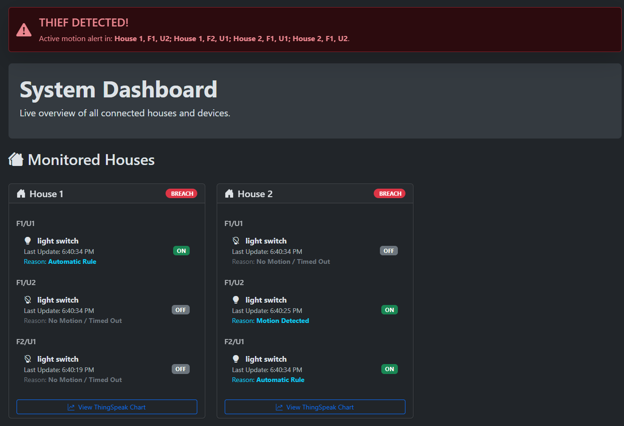
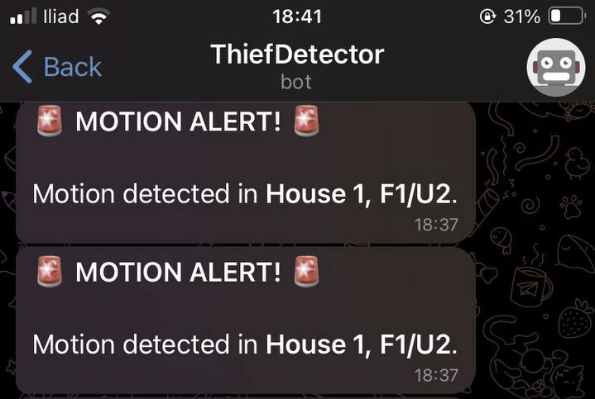
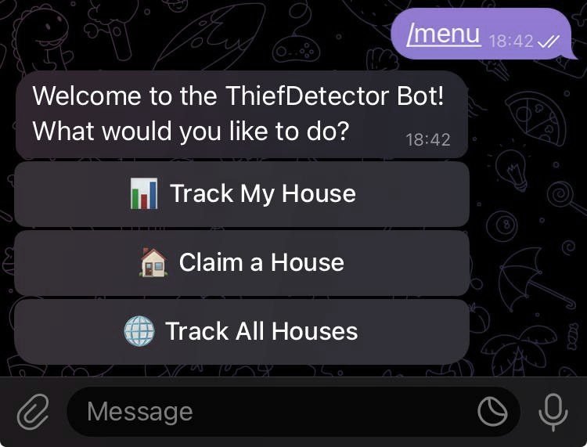
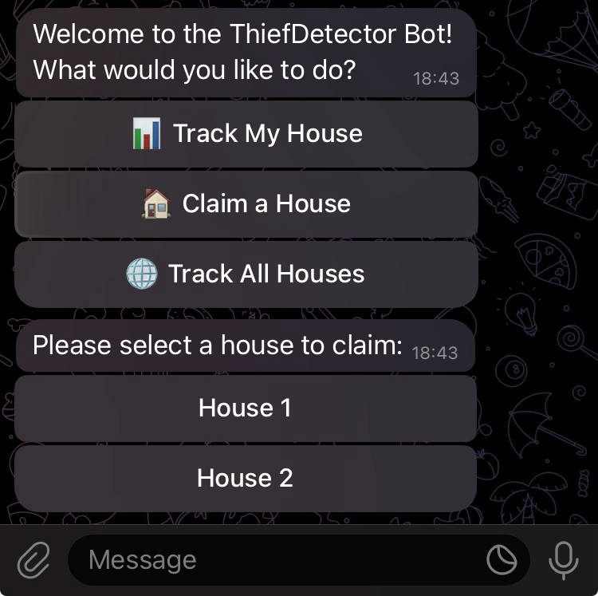
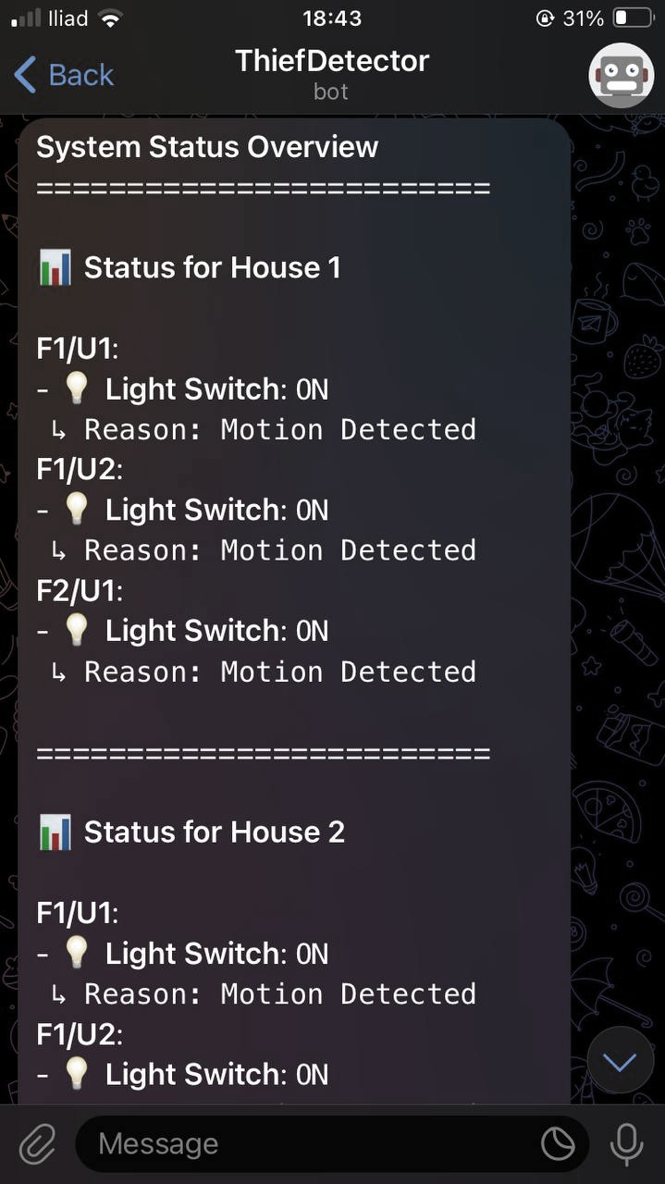
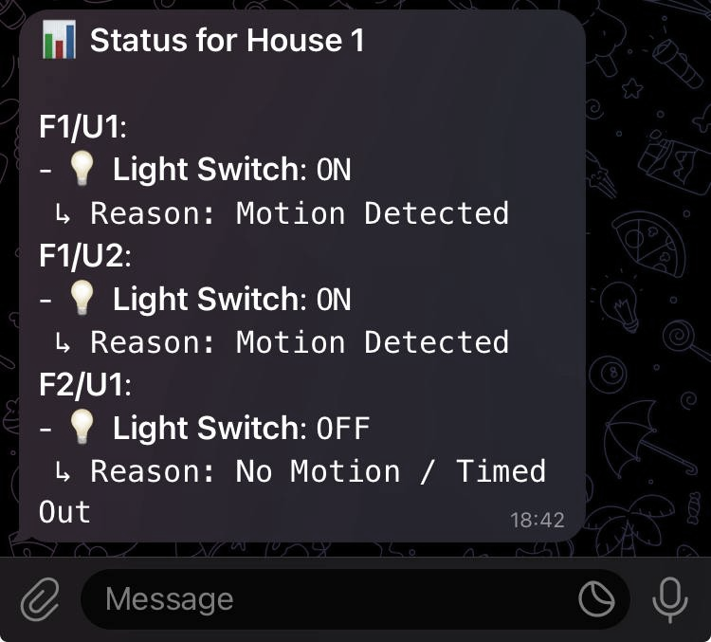
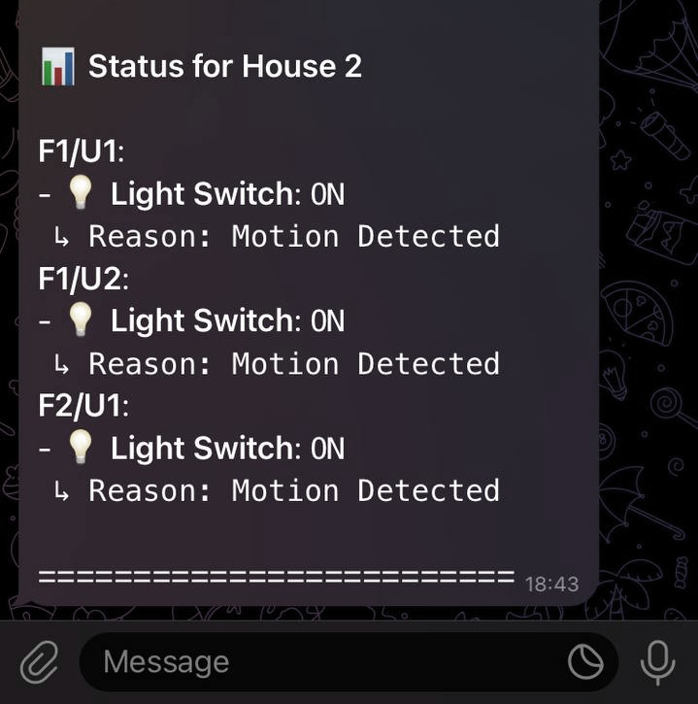
WEB APPLICATION
Provides user-friendly monitoring, without exposing users to raw MQTT or Catalog
House cards: quick scan; BREACH badge on active incidents
Hierarchy: Houses → Floors/Units → Devices
Per device: State, Last update, Reason (e.g., Motion / Timed Out)
Auto-refresh: updates every 5 seconds → pulls from Operator Control
Charts: one-click to ThingSpeak for history
Tech stack:
Front-end: HTML, CSS, JavaScript
Data/API: Python REST service (CherryPy)
Real-time messaging: MQTT (Mosquitto)
Deployment: Docker containers
Our Telegram bot gives chat-based control and awareness from any phone.
It sends proactive motion alerts as push messages and lets the user request a live status report without opening the dashboard.
Users first claim their house so notifications go to the right owner. Then they use quick actions—Track My House or Track All Houses—to see device states, last update times, and the reason for each state.
Notes:
This is the live dashboard of the Web Application. At the top, we have a global alert banner showing motion detection with exact location (house, floor, unit). Each house is displayed as a card with devices inside. The badge on top shows whether the house is SECURE or in BREACH. Devices are listed with their status, last update, and reason. The interface auto-refreshes every 5 seconds, so the operator always sees the latest status.

Slide 34
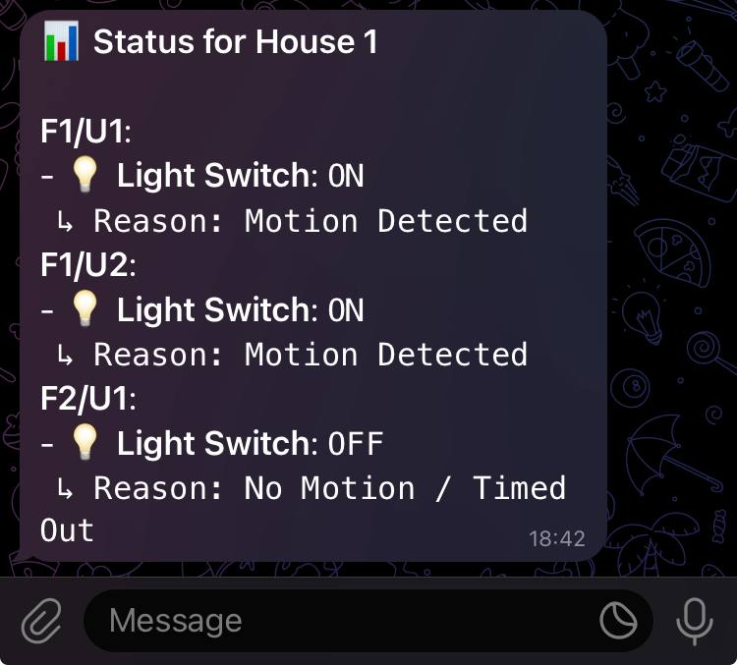
X
TELEGRAM BOT
ADMIN
PANEL
Our Telegram bot gives chat-based control and awareness from any phone.
It sends proactive motion alerts as push messages and lets the user request a live status report without opening the dashboard.
Users first claim their house so notifications go to the right owner. Then they use quick actions—Track My House or Track All Houses—to see device states, last update times, and the reason for each state.
application
2
Notes:
This is our Telegram bot. It listens to MQTT for real-time motion alerts and sends a warning to the right user. Users first claim their house so notifications go to the correct owner and selects own house. After that, by tracking their house, they can see a formatted report. Track all houses builds a system-wide overview that we want to consider it just for administrators, but in this project we did not implemented it yet.

Slide 35
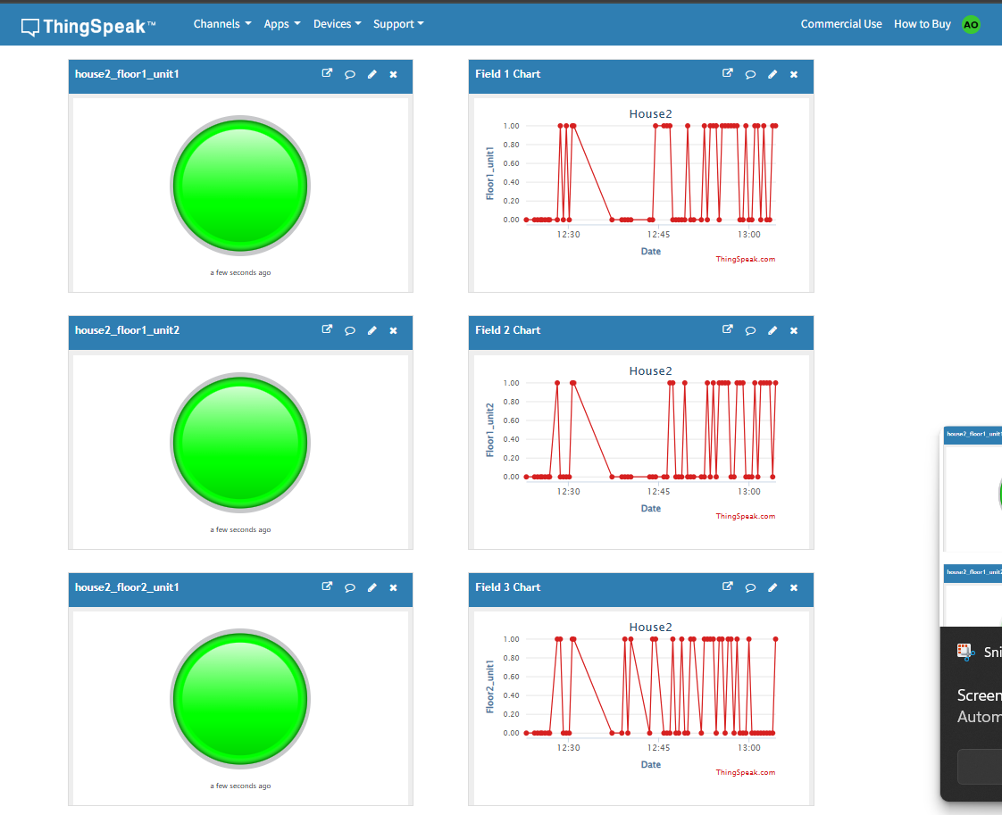
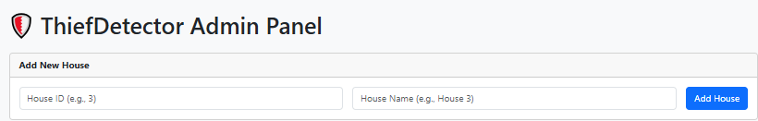
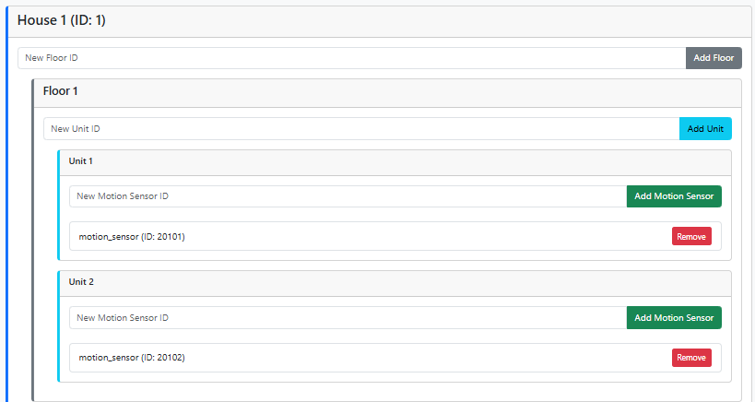
X
ADMIN
PANEL
application
THINGSPEAK -HOUSES 1 & 2
THINGSPEAK adaptor
Admin Panel
• Provides a semi-automatic way to add new spaces, houses, or sensors.
• Updates the Home Catalog through the Control Unit.
• The Home Catalog is dynamic:
• Any update made in the Admin Panel is immediately reflected in the Catalog.
• This ensures devices and configurations are always up to date.
• The web-based Admin Panel allows easy management and extension of the IoT system.
Static JSON Configuration
• In this project, the JSON files for sensors and actuators are static.
• Making them dynamic is possible, but it would add significant complexity.
• For the demo, only the Home Catalog is dynamic (updated via Admin Panel).
• To add or remove a new sensor/actuator, we must manually edit the JSON files.
Purpose: history beyond the live dashbThingSpeakoard
Flow: MQTT events → adapter → channel
Per unit: gauge (now) + line chart (trend)
Data: binary values — 1 = ON/Motion, 0 = OFF/No Motion
Acts as a bridge between the local MQTT broker and the ThingSpeak cloud platform.
It subscribes to sensor topics.
Buffers data and periodically sends it to ThingSpeak channels

Slide 36
X
ADMIN
PANEL
application
THINGSPEAK -HOUSES 1 & 2
THINGSPEAK adaptor
Purpose: history beyond the live dashbThingSpeakoard
Flow: MQTT events → adapter → channel
Per unit: gauge (now) + line chart (trend)
Data: binary values — 1 = ON/Motion, 0 = OFF/No Motion
Acts as a bridge between the local MQTT broker and the ThingSpeak cloud platform.
It subscribes to sensor topics.
Buffers data and periodically sends it to ThingSpeak channels

Slide 37
Admin Panel
THANK YOU.
THINGSPEAK -HOUSES 1 & 2
Sending Messages:
The Admin Panel sends Rest requests (e.g., JSON data like {"device": "Camera", "pin": 18, "space": "Hallway"}) to the Operator Control.
The Operator Control processes this and updates the system accordingly.
Receiving Messages:
It receives responses from the Operator Control (e.g., “Device added” or “Error: Pin in use”) via Rest.
It may also subscribe to MQTT topics (though not shown in the diagram) to get real-time feedback, like a confirmation that a new device is active.
Purpose: history beyond the live ThingSpeak dashboard
Flow: MQTT events → adapter → channel
Per unit: gauge (now) + line chart (trend)
Data: binary values — 1 = ON/Motion- Light Level,
0 = OFF/No Motion
THINGSPEAK adaptor
Acts as a bridge between the local MQTT broker and the ThingSpeak cloud platform.
It subscribes to sensor topics.
Buffers data and periodically sends it to ThingSpeak channels

Slide 38
THANK YOU.

